Slide 1
Wrapping up EUREKA
Andrew Hately, EUROCONTROL
EUREKA dissemination event, 7th May 2026
  This project has received funding from the SESAR3 Joint Undertaking under the European Union’s Horizon EUROPE research and innovation programme under grant agreement No 101114799

Slide 2
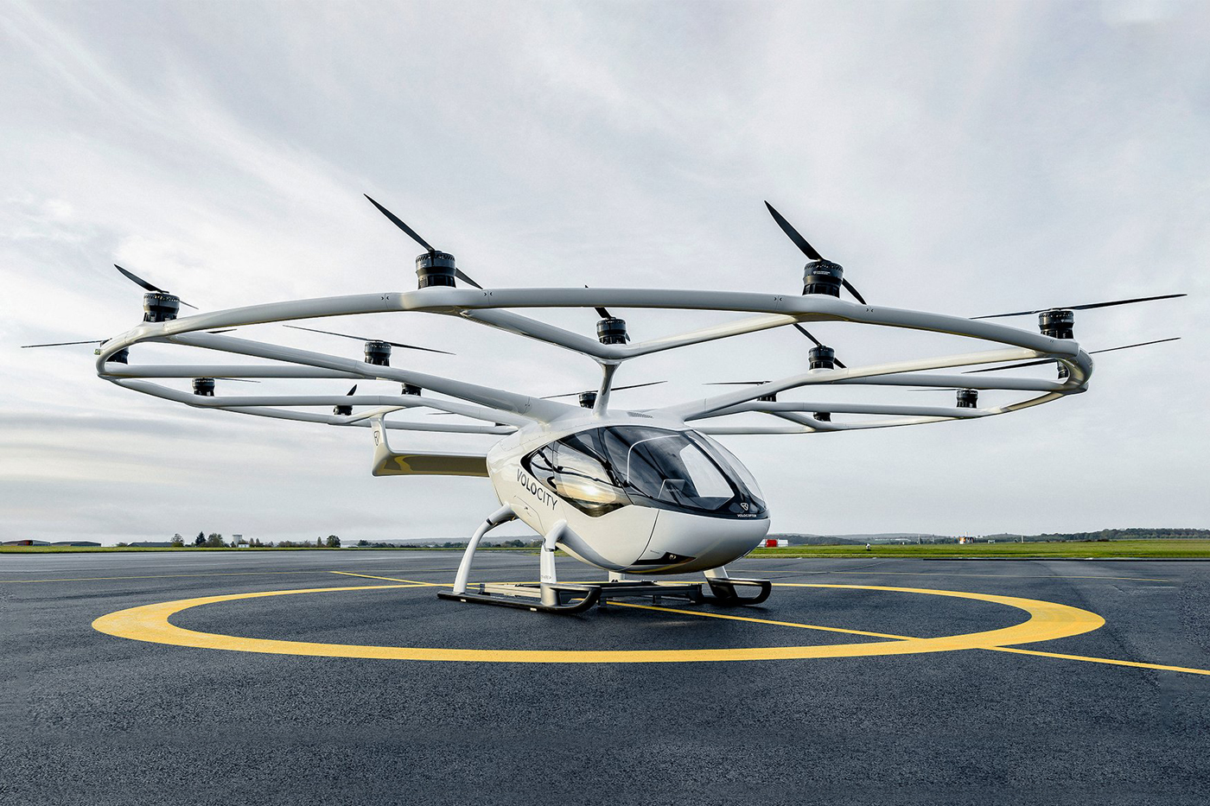
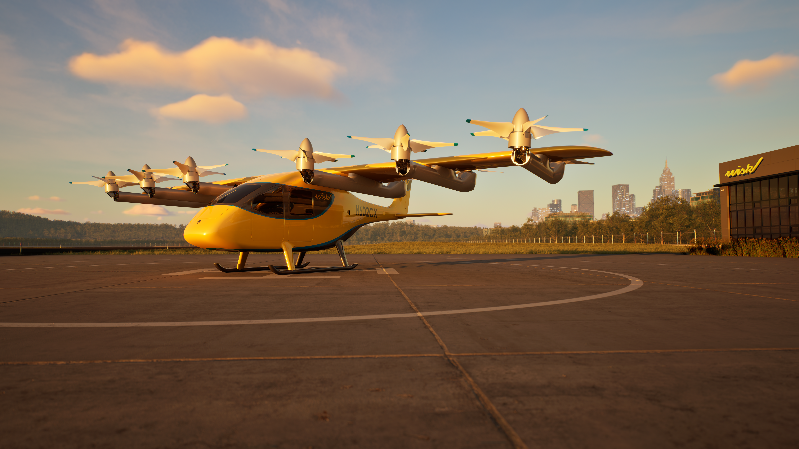
EUREKA is the first SESAR project (initially under full U-space scope) to extend the current scope of the existing ATM, air operations and U-space regulatory framework, in particular, for vertiport stakeholders.
Duration: 3 years – 2023 to 2026
Fast-track Project (TRL1/2 – TRL6/7): From basic principles observed to system prototype demonstration in operational environment
35 Partners.
1
This includes:
Introducing vertiports: Flight and operating procedure design for approach, departure to and from vertiports and en-route
Managing disruptions: Disruption management at vertiports
Vertiport collaborative traffic management: Who needs to communicate with whom?
Operating a vertiport network: Investigating the role of a Vertiport Network Manager
Reference Aircraft
©Volocopter
2
©Wisk

Slide 3
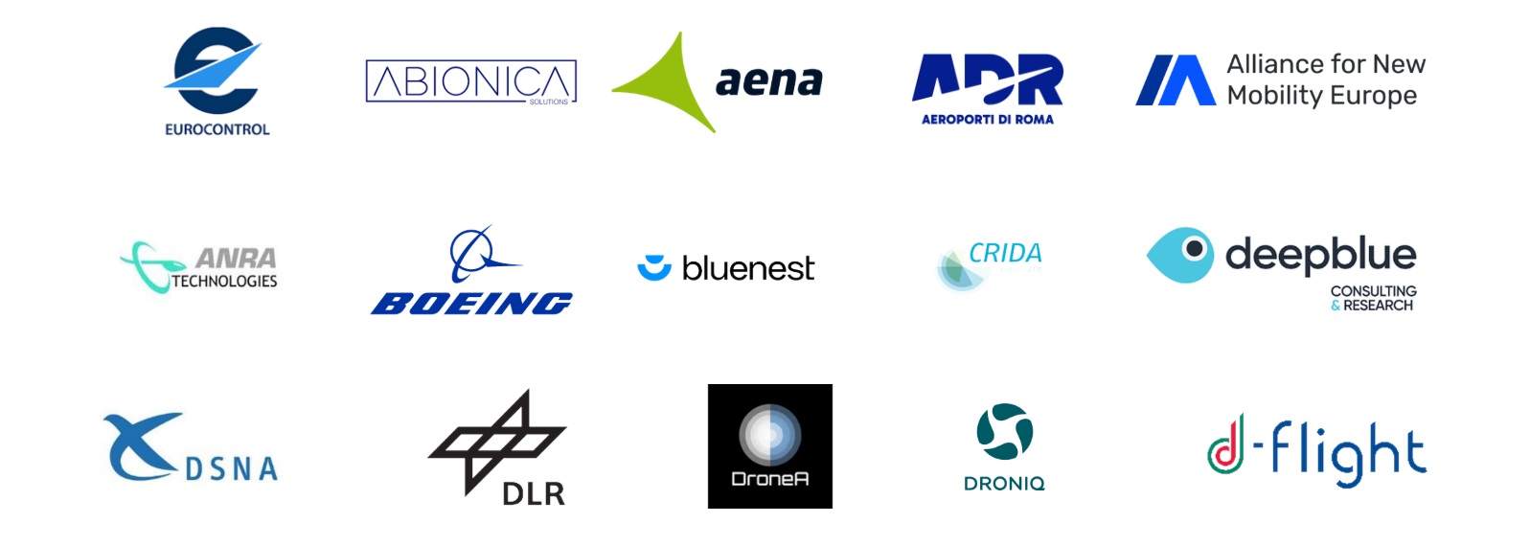
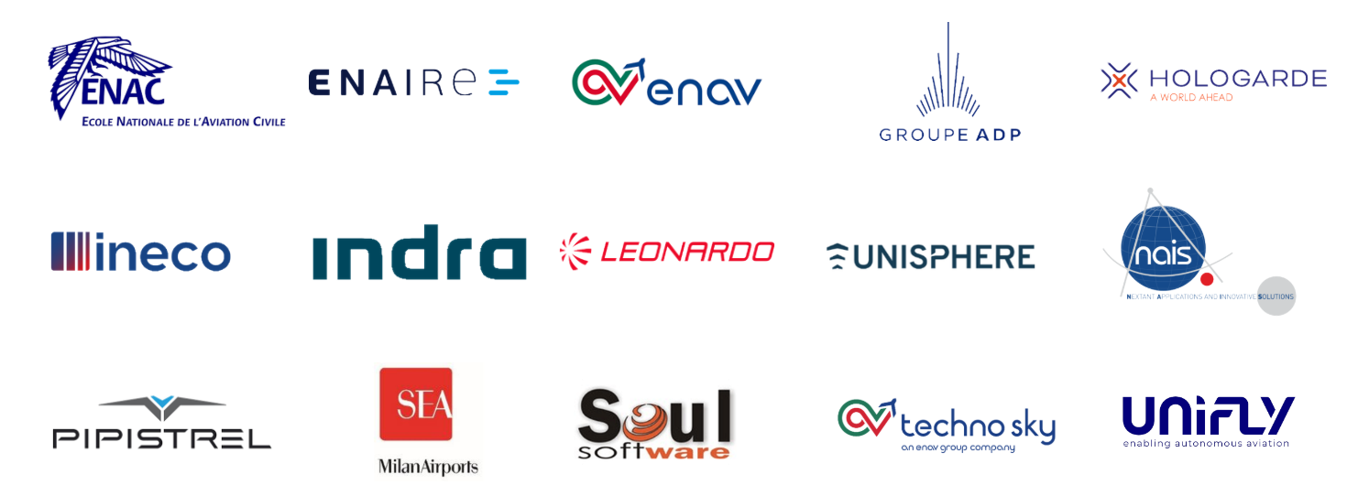
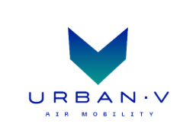

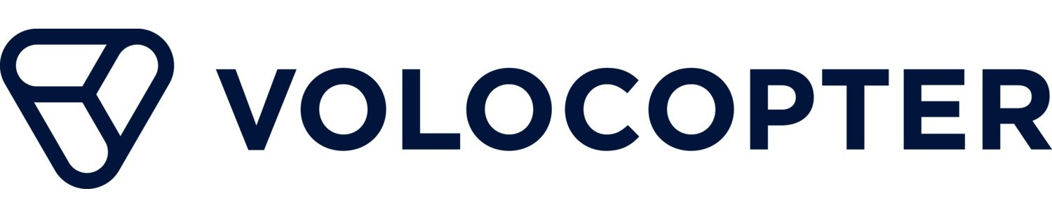
EUREKA
partners

Slide 4
EUREKA
people
Notes:
Change is the only constant.
The project launched in June 2023 with 35 member organisations

Slide 5
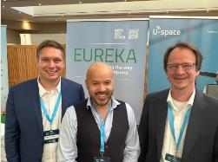
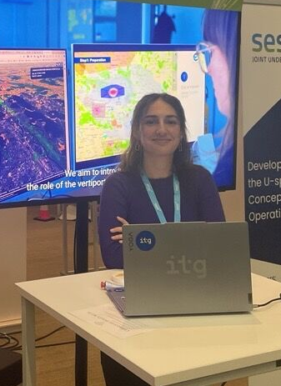
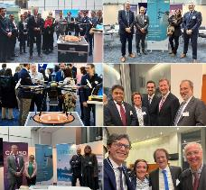
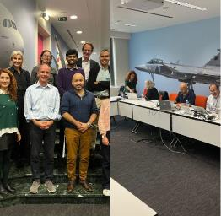
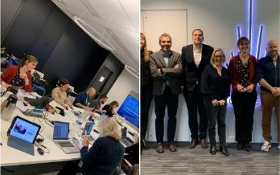
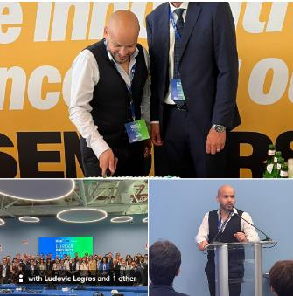
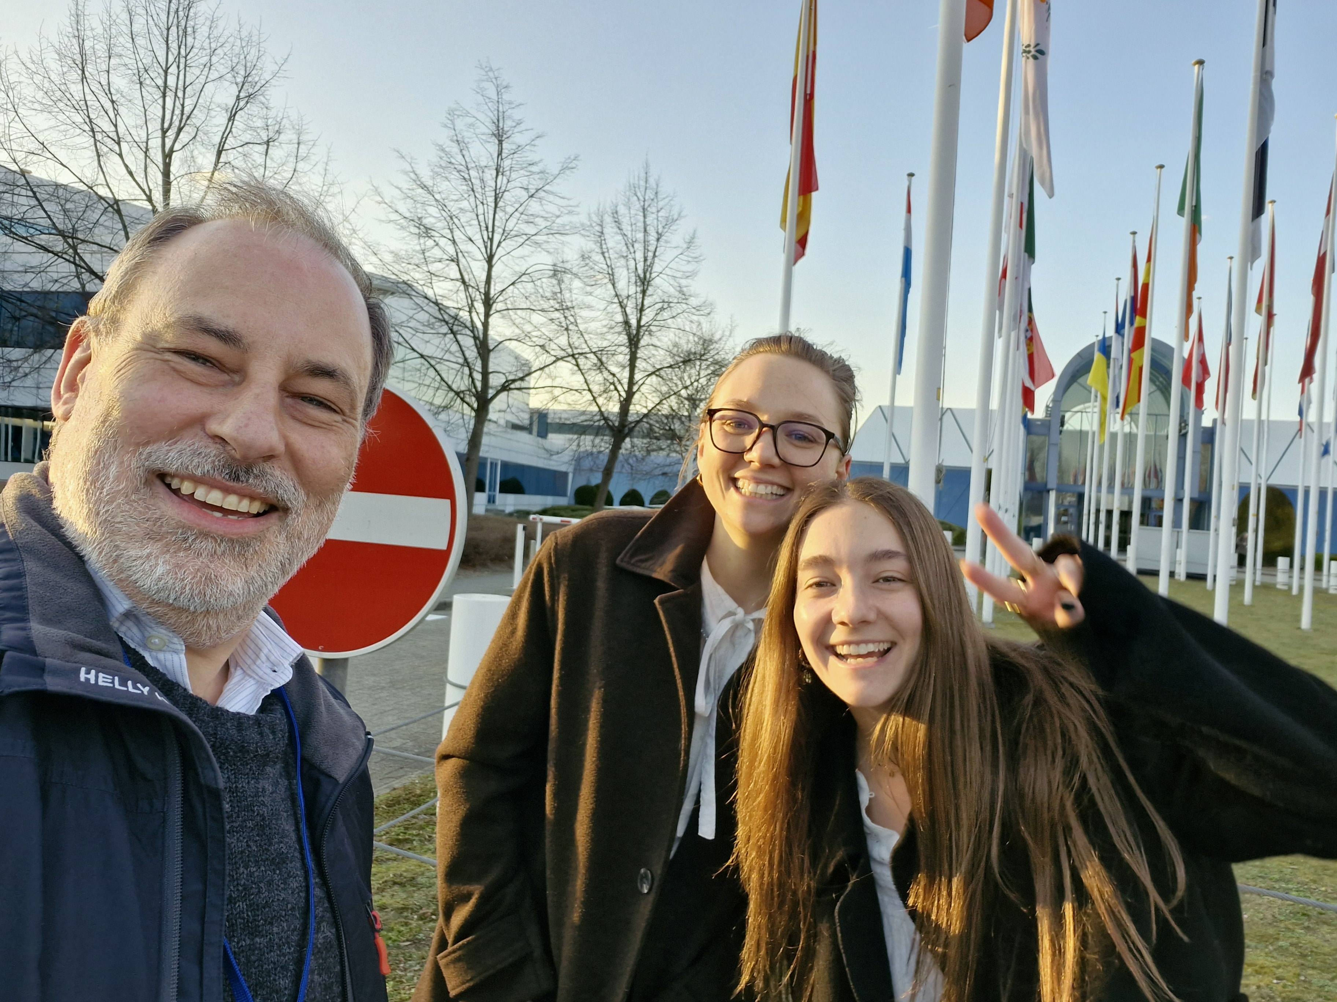
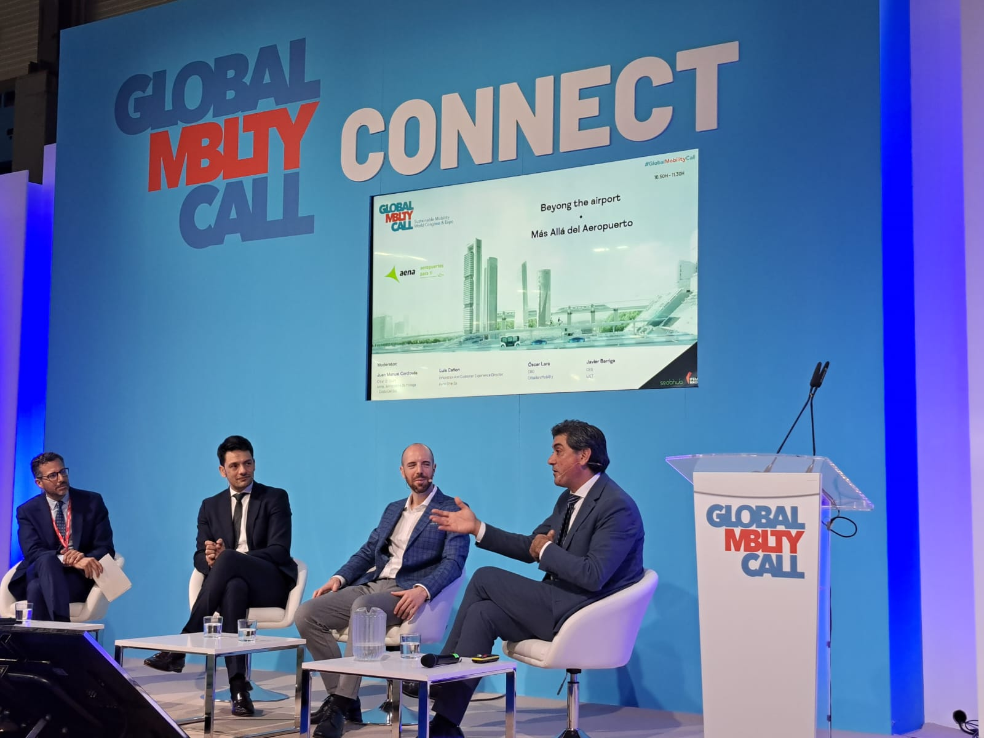
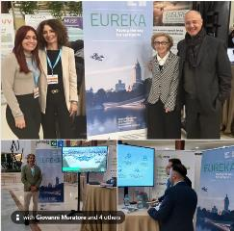
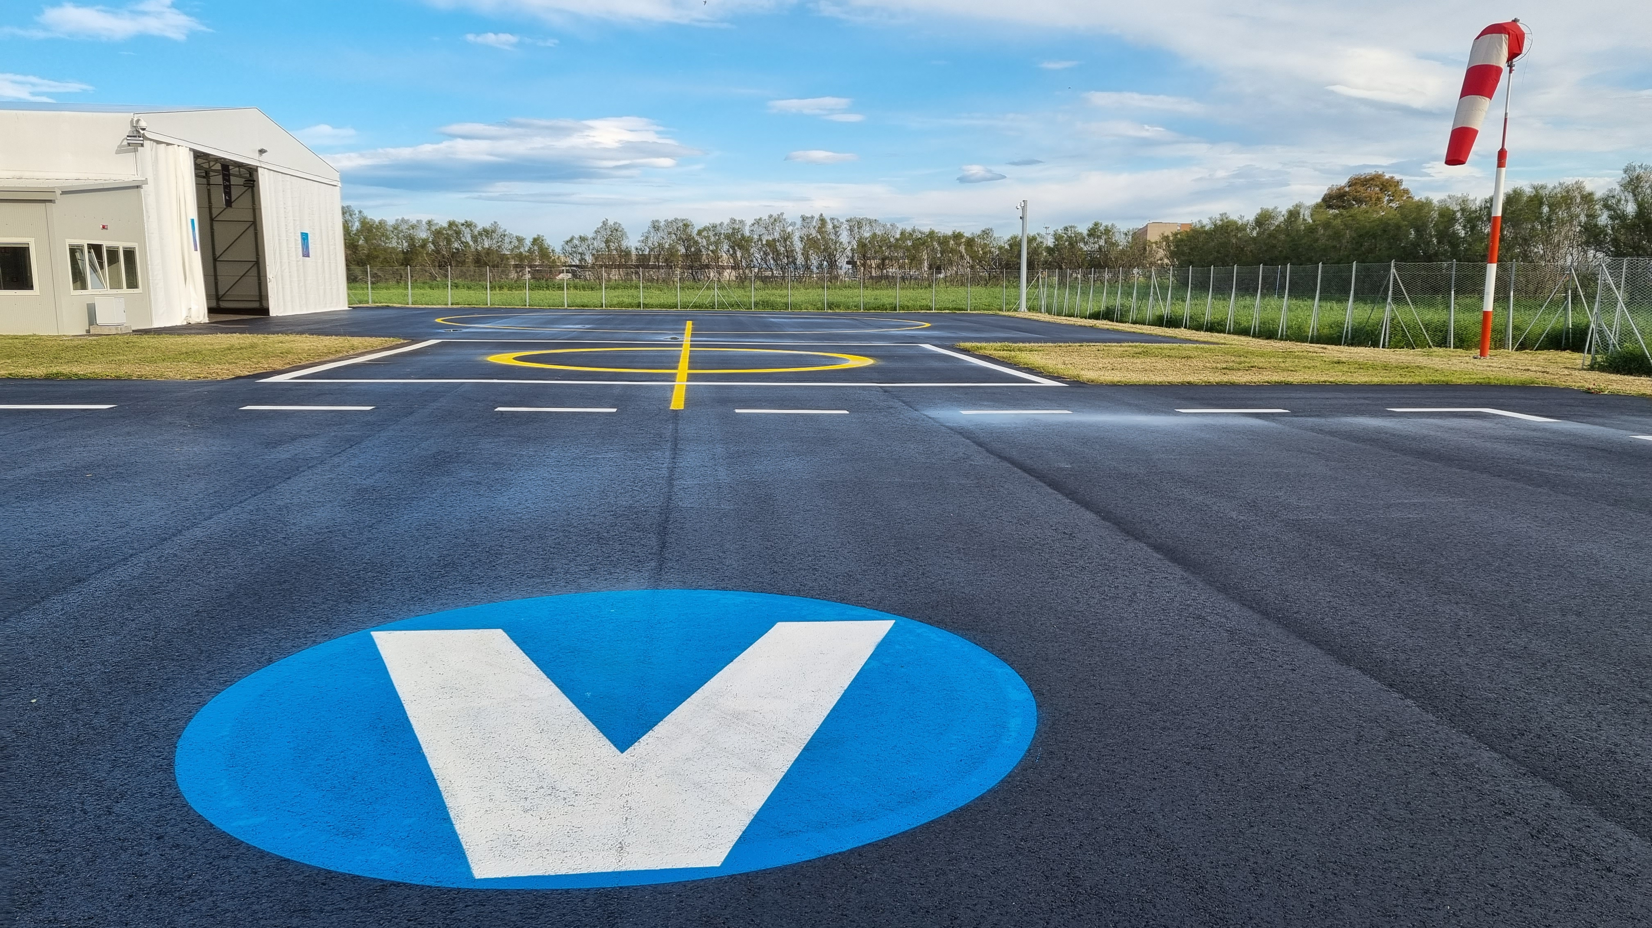

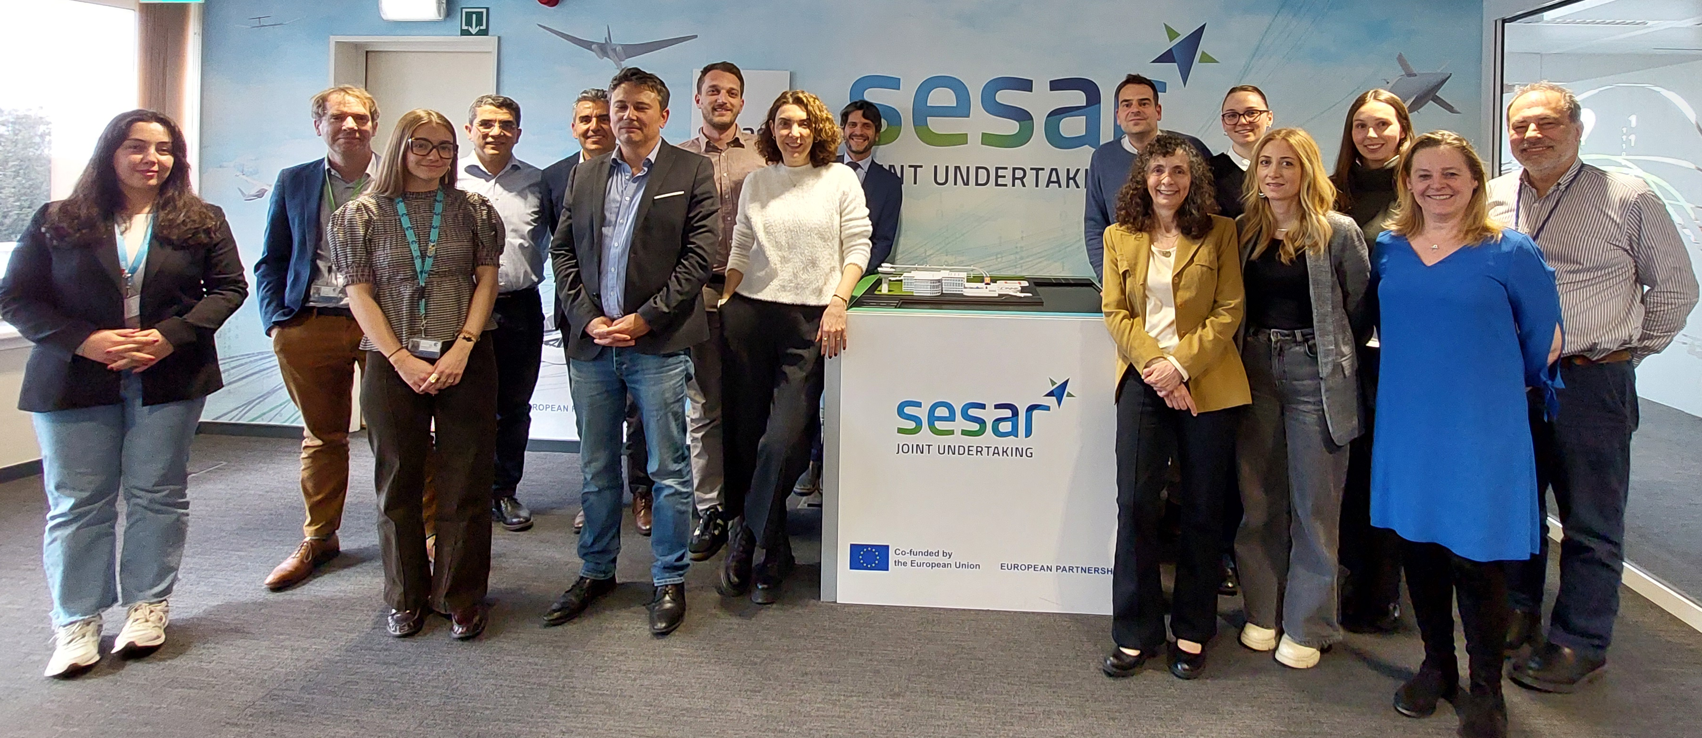
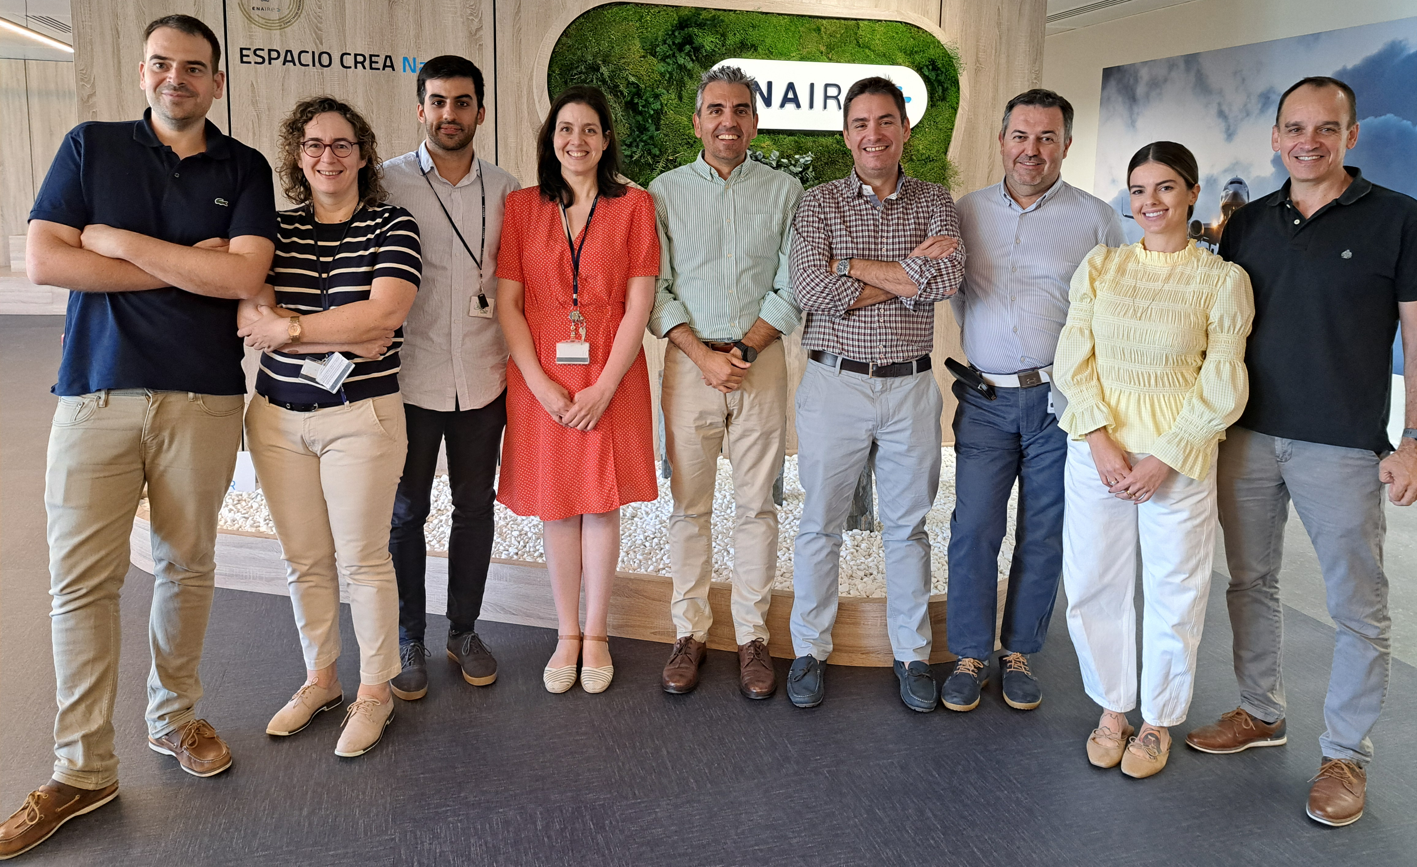
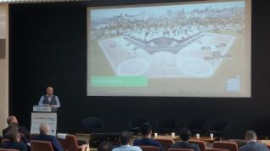
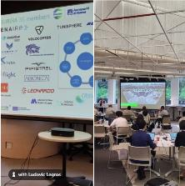
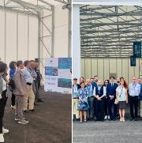
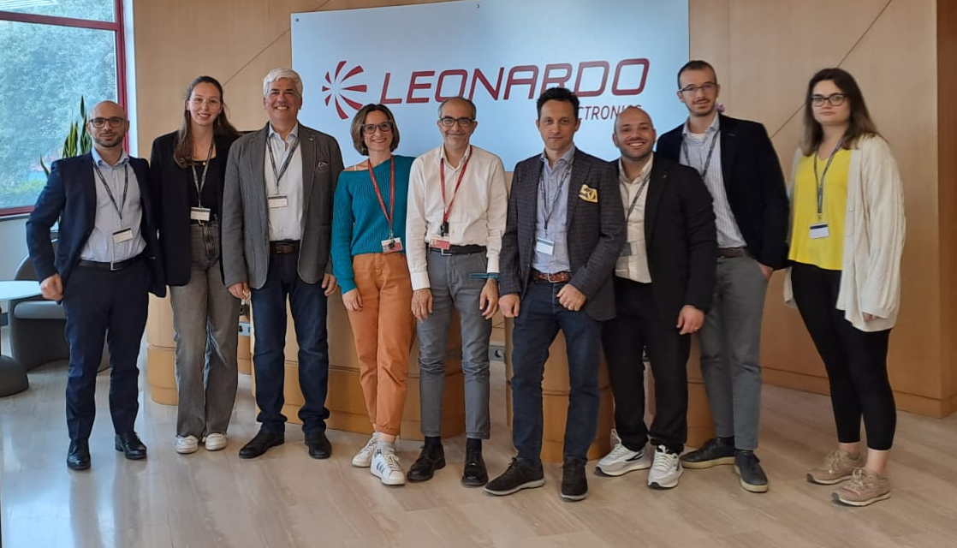
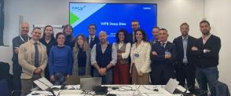
Notes:
Change is the only constant.
The project launched in June 2023 with 35 member organisations and hundreds of participants.
These pictures show some, but not all.

Slide 6
THANK YOU FOR
YOUR ATTENTION
  This project has received funding from the SESAR3 Joint Undertaking under the European Union’s Horizon EUROPE research and innovation programme under grant agreement No 101114799

