Slide 1
EUREKA-Solution-3 Breakout Session
Solution lead: BAS, SEA, Hologarde
07 May 2026

Slide 2
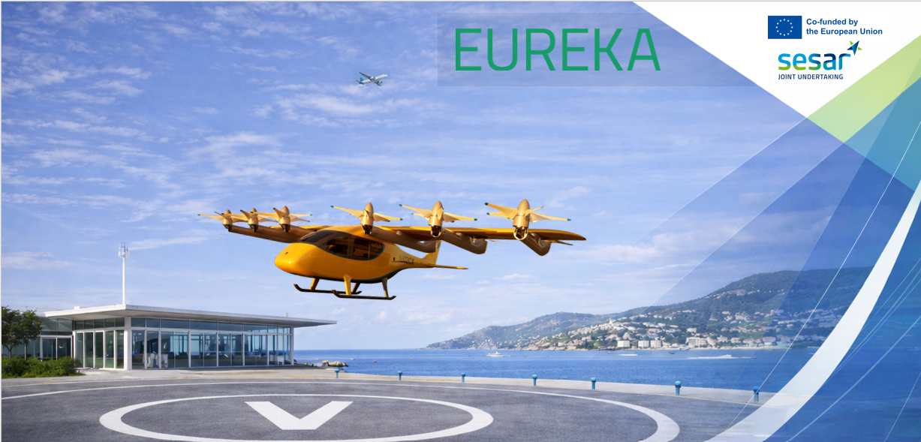
Sol. 0350 - VCA Flight and Operating Procedures for Safe and Resilient Vertiport Operations

Slide 3
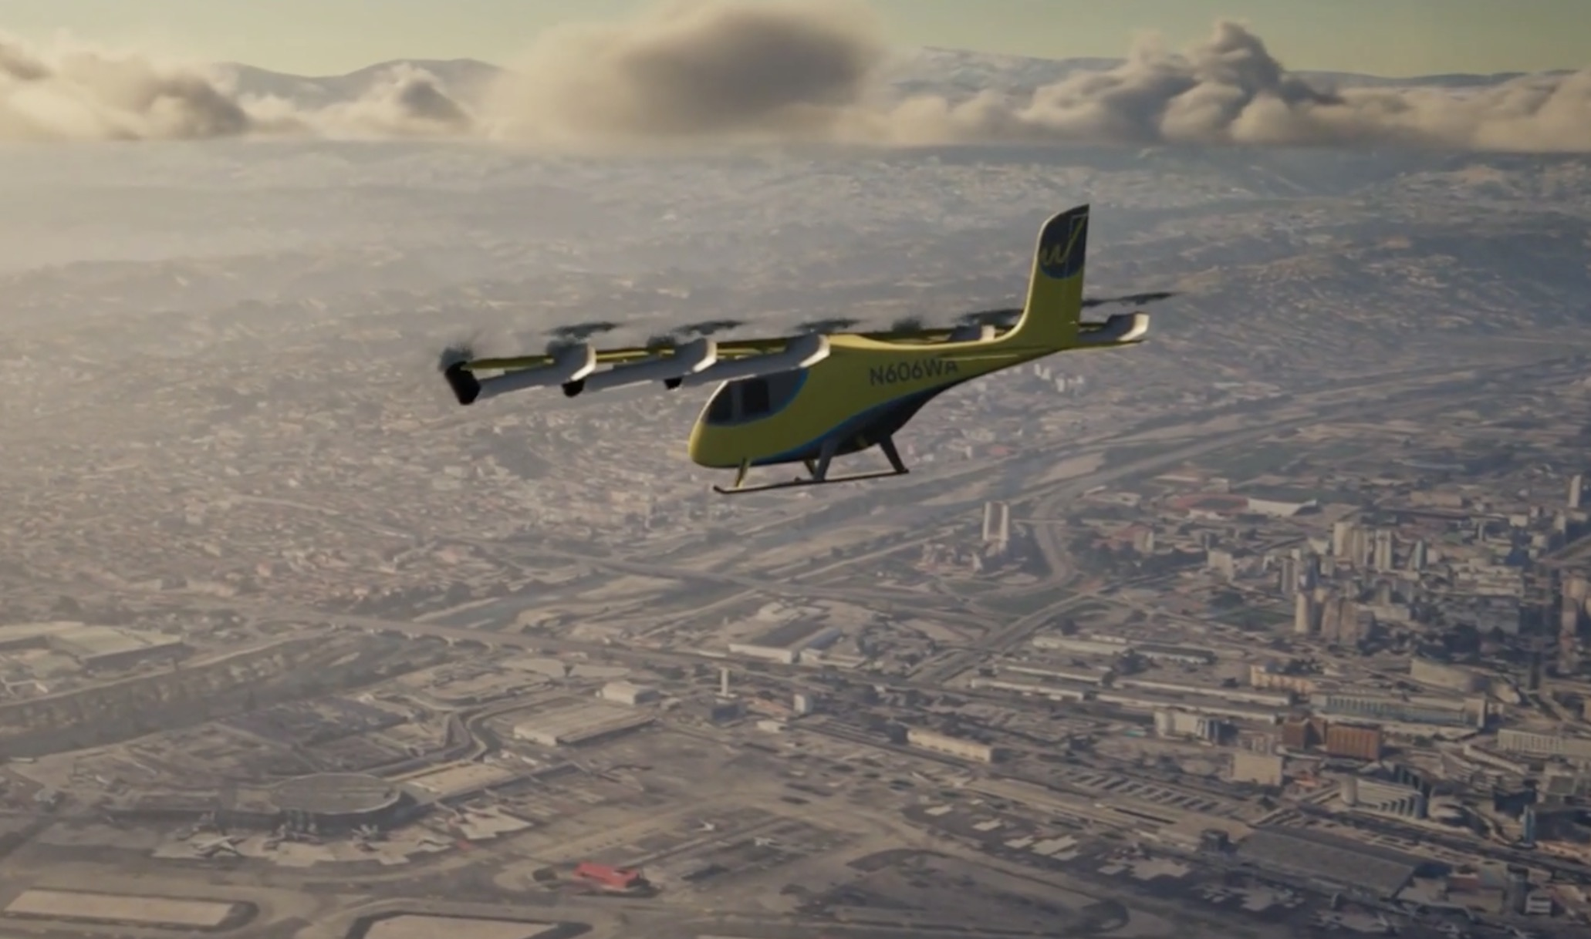
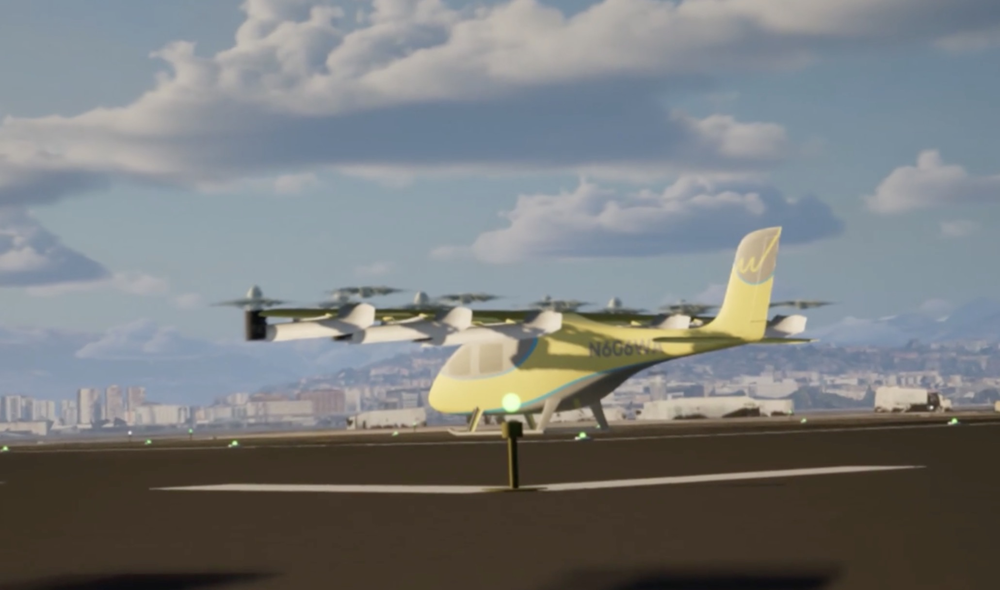
Solution Characteristics
Solution 3 examines the flight and operating procedures for VTOL capable aircraft (VCA) including arrival & departure procedures to and from vertiports, and the procedures along the associated routes and trajectories between them.
Flight and operating procedures for VCAs:
  VFR and IFR
  Multicopter and tiltrotor aircraft
  Airport and urban vertiports
  Vertiport Traffic Zone [roles & responsibilities]
  Contingency procedures
  Disruption management

Slide 4

Agenda
Solution 3 Contributions and General Discussion:
What is a Vertiport Traffic Zone?
Lack of scalability due to routes, separations and sequencing
Contingency procedures: diversion location reservations and communications
U-space supporting VCA operations
What are key drivers needed for advancing VCA industry in Europe?
MENTIMETER VOTE ON FAVORITE DISCUSSION TOPIC
Choose topics in order of popularity
Within each topic, we’ll provide quick overview of Solution contributions and conclusions, then make Mentimeter survey on agreement to promote further discussion.

Slide 5
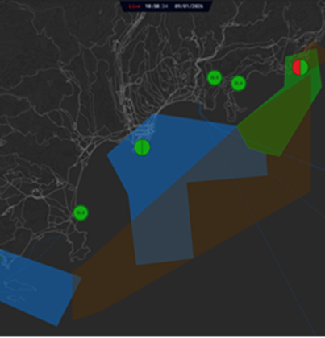
Topic 1
What is a Vertiport Traffic Zone?
The purpose is to streamline the roles and responsibilities of the VCA control authority during their approach and departure maneuvers across airspace classes, flight rules and operational environments based on a common set of requirements.
It shall enable the coordination of potential disruptions (e.g., missed approaches, deviations to alternative vertiports or diversion locations, the use of the contingency FATO during landing).
Thereby a common set of requirements can be established which transverses different modes of operation.
All traffic entering the VTZ must coordinate with the VTZ manager and respect the associated requirements.

Slide 6
Topic 1
What is a Vertiport Traffic Zone?

Slide 7
Topic 2
Lack of scalability due to routes, separations and sequencing
Manned VCAs are expected to enter operations flying with onboard pilots under VFR
+ existing procedures can be most easily adapted for this type of operations
+ minimum required separations are relatively low
- cannot operate in low visibility conditions
- sequencing still needed in terminal areas adjacent to airports
Alternatively, some operators may opt to fly under IFR
    + better safety case
    + much broader set of operational conditions
    - must fly according to prescribed separations designed for large conventional airlines
    - highly constrained in terminal areas due to large separations distances

Slide 8
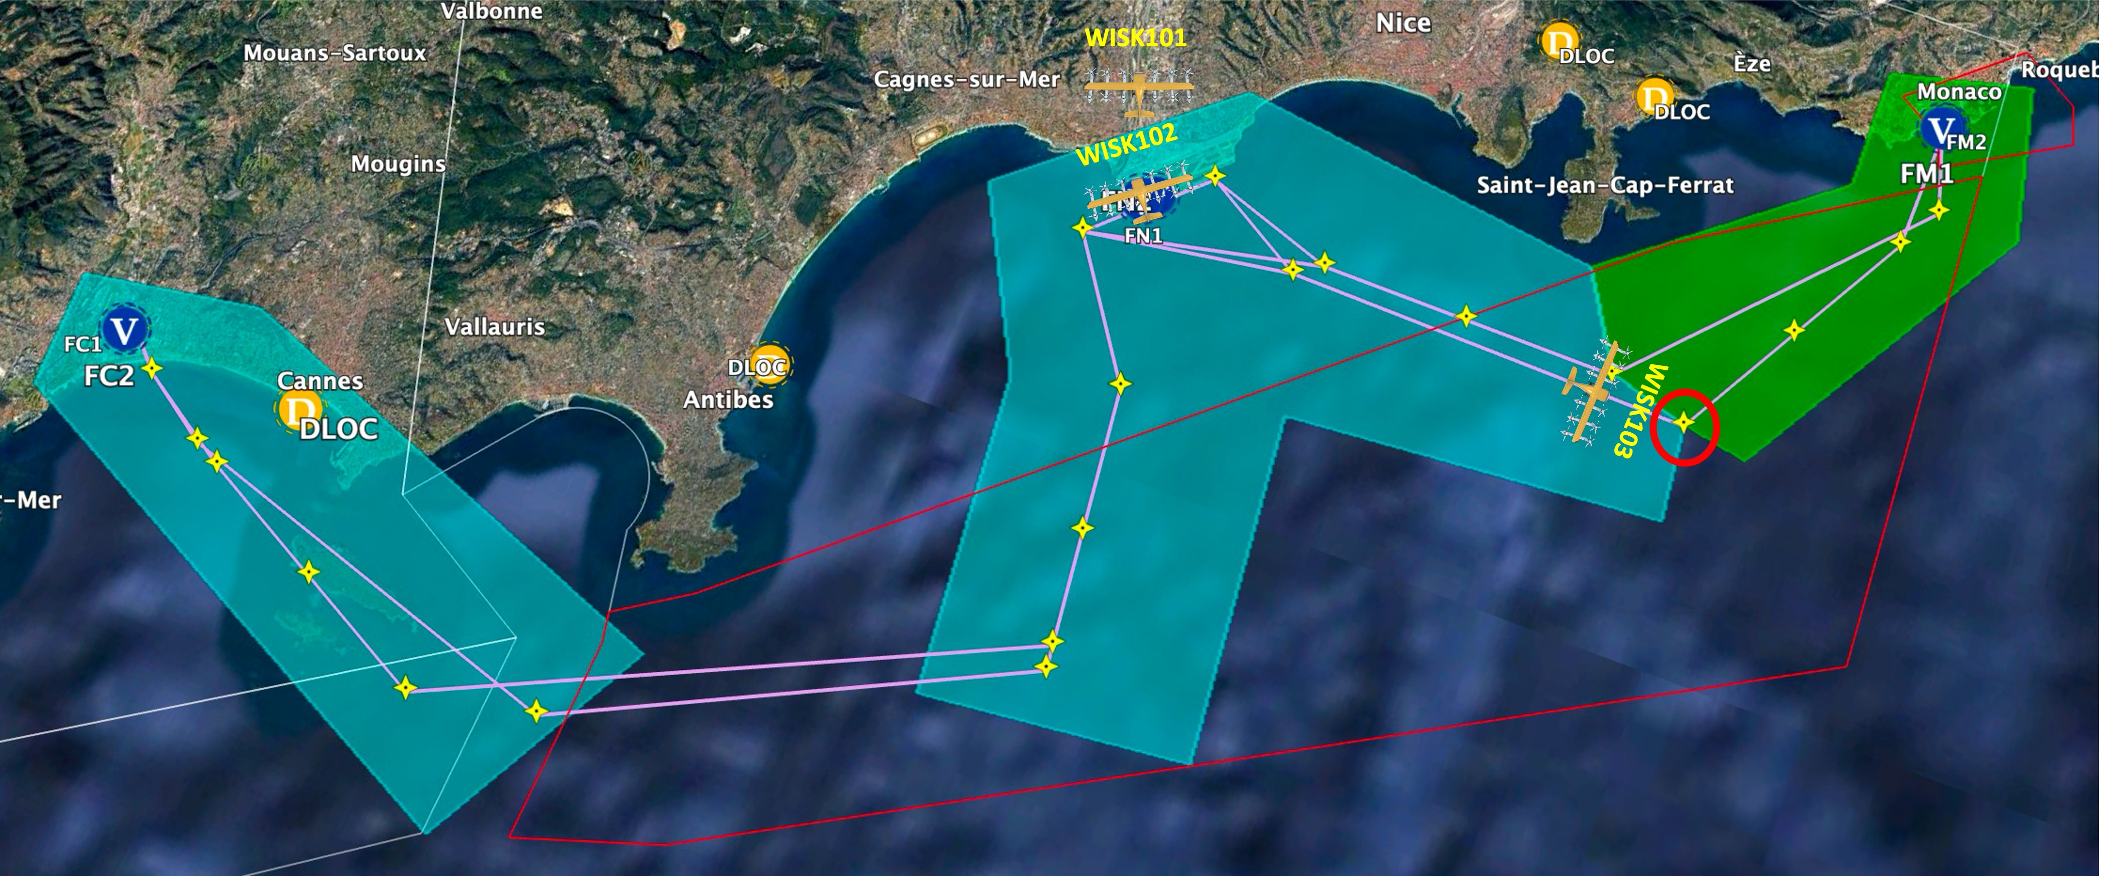
Topic 2
Lack of scalability due to routes, separations and sequencing
What measures can best serve to increase network capacity?
  Performance-based separation
  Simultaneous non-interfering operations of vertiports at airports
  U-space services which maximize efficiency and throughput

Slide 9
Topic 2
Lack of scalability due to routes, separations and sequencing

Slide 10
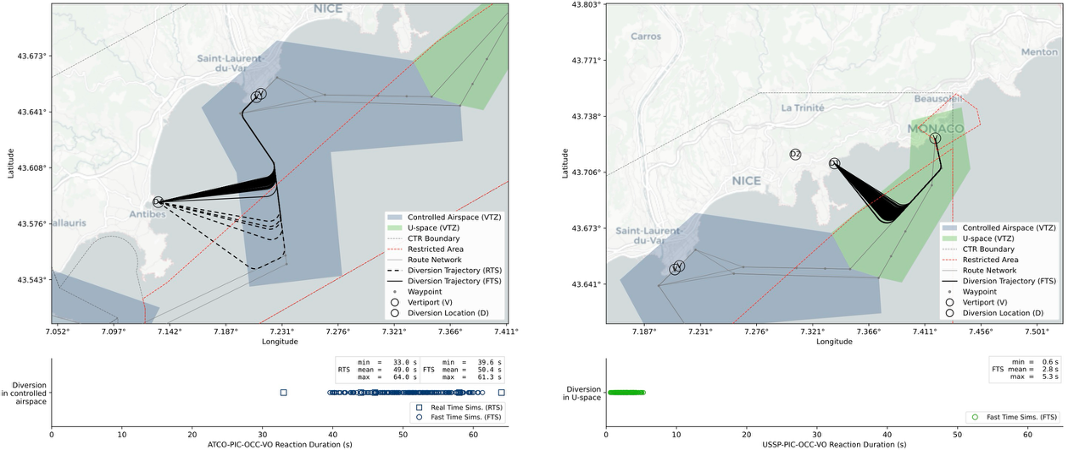
Topic 3
Contingency procedures: diversion location reservations, communications
Contingency procedure
Controlled airspace: PIC (&OCC) ➞ ATCO ➞ PIC ➞ OCC ➞ VO ➞ OCC ➞ PIC ➞ ATCO ➞ PIC
U-space airspace: PIC (&OCC) ➞ USSP (CDS) ➞ PIC ➞ ATCO ➞ PIC
Potential Discussion Points
How can this communication flow be made more efficient?
Is real-time contingency booking necessary or should it be addressed at the strategic phase?
What would be the operational implications, limitations, and drawbacks?

Slide 11
Topic 3
Contingency procedures: diversion location reservations and communications

Slide 12
Topic 4
U-space supporting VCA operations
Initial Operating Environment
USSP provides situational awareness to UAM operators
[Y volume in uncontrolled airspace
Za volume in controlled airspace]*
Network Identification Service
Geo-Awareness Service
  performs geofencing of VTZs and UAM corridors
Traffic Information Service
Conformance Monitoring Service
Weather Information Service
Intermediate Operating Environment
USSP provides advisories to UAM operators and coordinates with ATC
[Y volume in uncontrolled airspace
Za volume in controlled airspace
+ strategic deconfliction]*
Contingency Decision Support Service
  contingency diversion location verification and recommendation
  missed approach recommendation related to vertiport infrastructure unavailability
Traffic Flow and Capacity Management Service
  fleet strategic deconfliction including sequencing at destination vertiport
CNS Performance Monitoring
Geospatial Information Service
Procedural Interface with ATC
Final Operating Environment
USSP acts as managing authority for VCAs in U-space
[Zz volume in uncontrolled airspace
Zu volume in controlled airspace]*
VTZ manager
  Vertiport sequencing
  Coordinate air & ground traffic
Tactical Conflict Resolution
Dynamic Capacity Management
Collaborative Interface with ATC
  Handover with ATC when entering & leaving U-space
* Corus U-space ConOps 4th Ed.

Slide 13
Topic 4
U-space supporting VCA operations – Timeline Vision

Slide 14
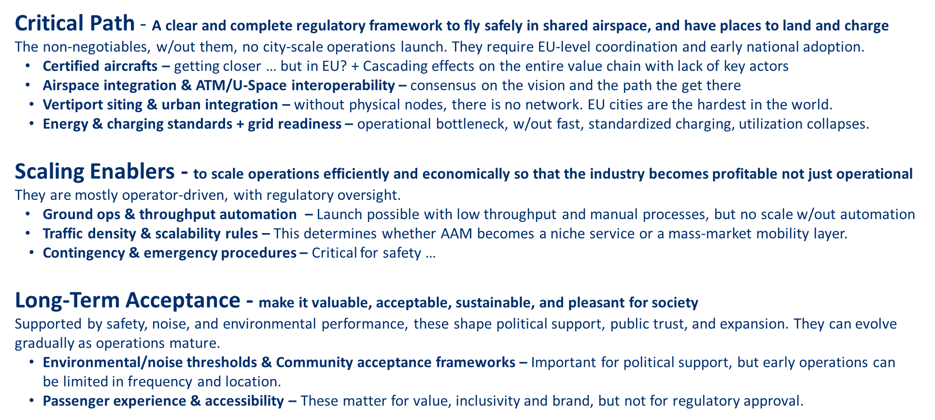
Topic 5 - Key drivers for advancing VCA industry in EU?
Notes:
Strong public‑private investment in technology and infrastructure
Private: risk aversion … Without predictable certification and operational rules, OEMs cannot industrialize, investors hesitate, and operators cannot plan viable networks.
Public contribution limited,
Huge gaps in terms of key actors (OEMs, Operators)
Airspace integration & ATM/U‑Space interoperability – Aircraft certification is nearly done. Airspace integration is the single biggest unresolved bottleneck
How will piloted eVTOLs interact with U‑Space services originally built for drones?
What separation minima and procedures apply to mixed traffic (eVTOLs, helicopters, drones)?
Who manages low‑altitude airspace (ANSP vs U‑Space provider vs hybrid)?
What is the operational concept for dense urban corridors?

Slide 15
Topic 5 – What are key drivers for advancing VCA industry in EU?

