Slide 1
EUREKA
Standardisation & Regulation
Nathalie Kühn & Andrew Hately EUROCONTROL
EUREKA dissemination event, 7th May 2026
  This project has received funding from the SESAR3 Joint Undertaking under the European Union’s Horizon EUROPE research and innovation programme under grant agreement No 101114799

Slide 2
Overview
What is Standardisation and Regulation
What are Standardisation & Regulation deliverables
How EUREKA reports Standardisation & Regulation needs
EUREKA’s approach to Standardisation and Regulation
Key outcomes, by solution
Notes:
Nathalie: I added a quick slide about what Standardisation and Regulation is/are, and one on the approach that we developed in EUREKA

Slide 3
What is Standardisation and Regulation
Regulation => the legal binding framework established by the European Union that sets mandatory safety, security, environmental, and operational requirements for aviation.
Standards => process of developing technical standards and acceptable means of compliance that describe how regulatory requirements can be met in a harmonised way across Europe.
Notes:
Nathalie: feel free to change/remove/improve

Slide 4
Standardisation & Regulation deliverables
SESAR research and innovation develops solutions
  A solution => combination of operational and technical changes that creates an improvement
Solutions link to Regulation and Standardisation
  In and of themselves
  Through their enablers
    Technical changes expected to be present to allow the solution to be applied
  Through the operational context in which they can be applied
    Assumptions in the research that need to exist to allow deployment
SESAR solutions rely on Regulatory change and Standard development to be deployed
The STAND and REG deliverables communicate these needs
Notes:
Animated
Feel free to expand this into two or more slides.
Nathalie: I think it is good like this

Slide 5
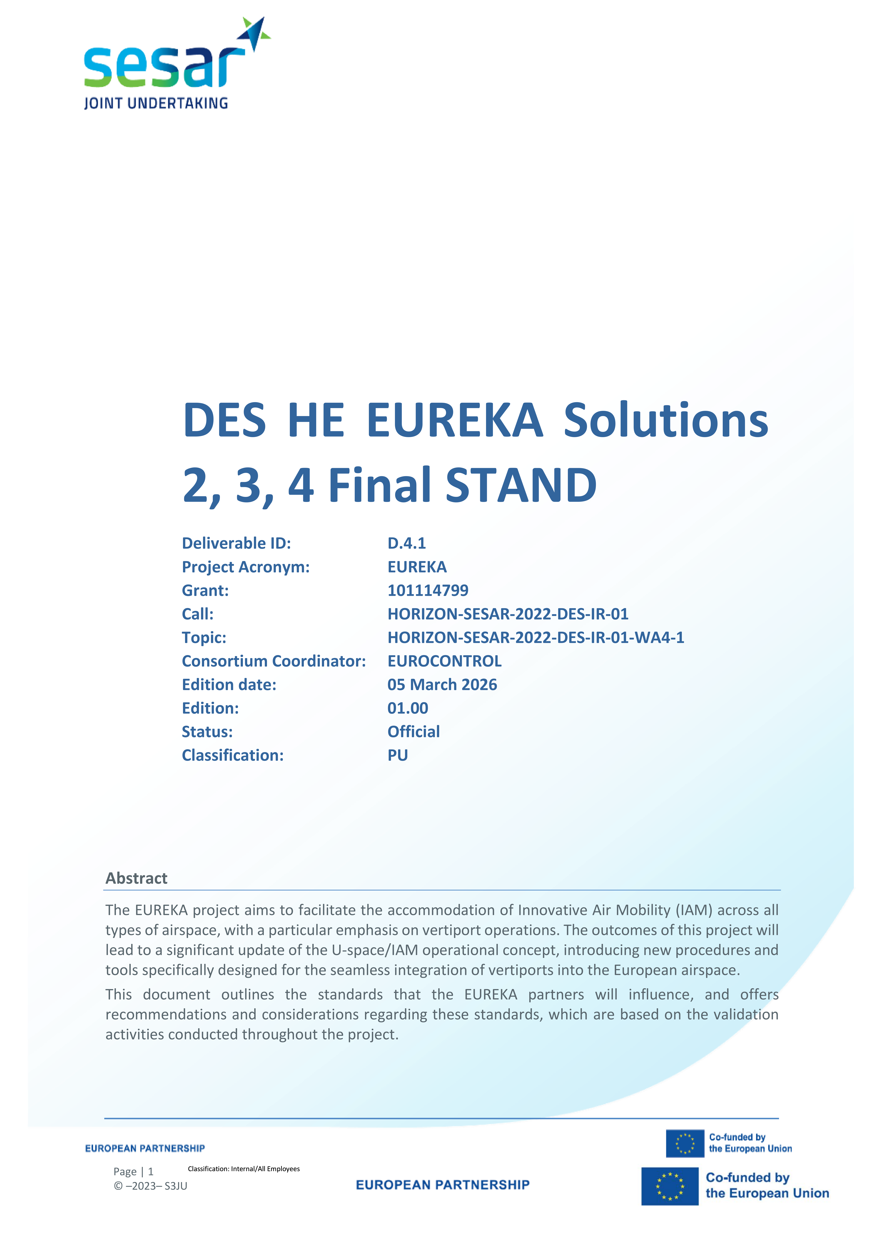

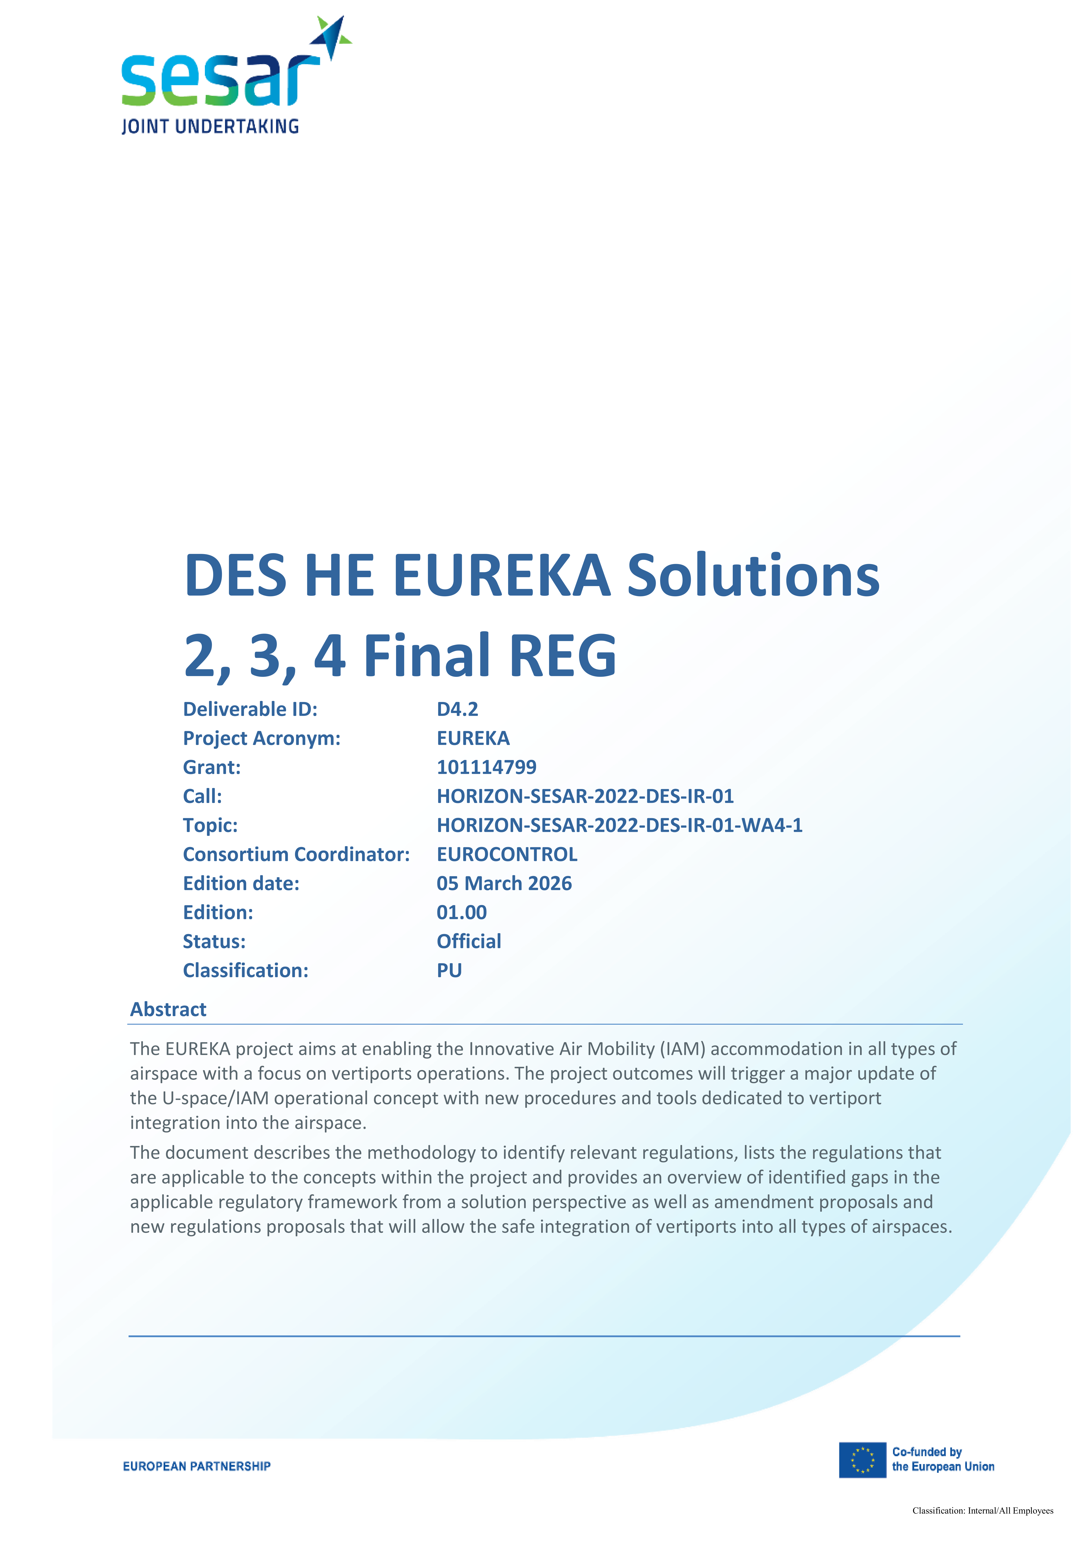
Three solutions, two deliverables, one work package
Approach/Departure Flight and operating procedure design and en-route and disruption management at vertiports
Vertiport Network Management
Vertiport Collaborative Traffic Management
Notes:
Animated
Nathalie: I like it, I just tried to reduce the title for Sol 3

Slide 6
Own approach to Standardisation and Regulation
Approach/Departure Flight and operating procedure design and en-route and disruption management at vertiports
Working Groups
WG 1: Vertiports
WG 2: U-Space Services
WG 3: ATM/U-Space Integration
WG 4: Capacity, Safety, Security, and Efficiency
Working Groups
Vertiport Network Management
SDO
Vertiport Collaborative Traffic Management
Facilitate cross-functional collaboration among solutions
Notes:
Nathalie: I used the same visual to briefly introduce the working group that we created within EUREKA, to allow for a smooth and cross-functional exchange among the different solutions in terms of Stand & Reg, to ensure a 360 view on all the different needs and get rid of duplicates/redundancy. This approach is based on some interesting work done by Cecilia in U-ELCOME – good to mention her/them for credit

Slide 7
The regulatory and standardisation background to EUREKA
REG
U-space regulatory framework (REG 2021/664-665-666)
EASA Prototype Technical Design Specifications for Vertiports (PTS-VPT-DSN)
RMT.0230 Introduction of a regulatory framework for the operation of unmanned aircraft systems and for urban air mobility in the European Union aviation system
STAND
ED-299: Guidance for Vertiport Operators and Operations
ED-269: Minimum Operational Performance Standard for UAS GeoFencing
ED-318: Technical Specification for Geographical Zones and U-Space data provision and exchange
ASTM F3423/F3423M-22: Standard Specification for Vertiport Design
ASTM F3548-21: Standard Specification for UAS Traffic Management (UTM) UAS Service Supplier (USS) Interoperability
Notes:
Nathalie, try to add a few bullets here. Or delete the page
Nathalie: Done -> these are the main Reg and Stand used, there are other ones that are targeting specific solutions, but here is an overview of the ones that have transversal setups

Slide 8
Solution 2 key needs: Vertiport Collaborative Traffic Management
Recognise vertiport infrastructure as an aviation installation with defined safety and operational data obligations.
Define operator responsibilities for V‑CTM processes and common information provision.
Formally introduce the Vertiport Manager Operator as a regulated actor with operational responsibilities.
Introduce requirements for digital interoperability.
Add vertiport‑specific U‑space services.
Enable integration of manned VTOL/VCA within U‑space when operating under IAM.
Integrate requirements for BVLOS / automated IAM operations.
Mandate the exchange of common operational information.
Provide regulatory support to VCTM processes within the U‑space ecosystem.
Adapt operator obligations when acting as IAM Operator within a VCTM environment.
Notes:
Should this be preceded by a description of solution 2?
Nathalie: ➔ I would just mention what it is about, since they will present a detailed description of their solution

Slide 9
Solution 3 key needs: Approach/Departure Flight and operating procedure design and en-route and disruption management at vertiports
Extend EASA RMT.0230 to include VCA IFR operations, vertiport IFR design, VTZ definition & MOC/OLS mismatch correction.
Add IFR vertiport design in EASA PTS-VPT-DSN & resolve take-off/OLS mismatch.
Standardise ATC-USSP handover, VTZ Manager role, ATC-USSP communication protocols & clarify dual responsibility.
Detailed contingency procedures.
Regulatory development of U-space Flight Rules.
Extend data model to include consideration of UAM corridors and Vertiport Traffic Zones & consideration of obstacles.

Slide 10
Solution 4 key needs: Vertiport Network Management
Clear definition of the new roles introduced in this solution (“Vertiport Network”, “Local Vertiport Network Manager”, …) and their responsibilities.
Need of static and dynamic information available concerning the vertiport status.
Need of description & clarification on the slot availability verification process.
The formalisation of the use of ISO/IEC 19464 (AMQP 1.0) within a dedicated EUROCAE standard is necessary to ensure harmonised, interoperable, and scalable exchange of meteorological information between Weather Information Providers and USSPs across the European U-space ecosystem.

Slide 11
Conclusion
“Without supporting regulatory and standardisation frameworks, there is no innovation deployment”
Notes:
Nathalie: Do we need a conclusion? I was thinking about emphasising the importance of stand and reg in the innovation process. Feel free to re-work this part if needed/if you want to keep it

Slide 12
THANK YOU FOR
YOUR ATTENTION
  This project has received funding from the SESAR3 Joint Undertaking under the European Union’s Horizon EUROPE research and innovation programme under grant agreement No 101114799

