Slide 1
EUREKA Final Conference, Cologne, 07 May 2026
EUREKA
European Key Solutions for Vertiports and Urban Air Mobility
Overarching Concept of Operations
Marzia Corsi
  This project has received funding from the SESAR3 Joint Undertaking under the European Union’s Horizon EUROPE research and innovation programme under grant agreement No 101114799

Slide 2

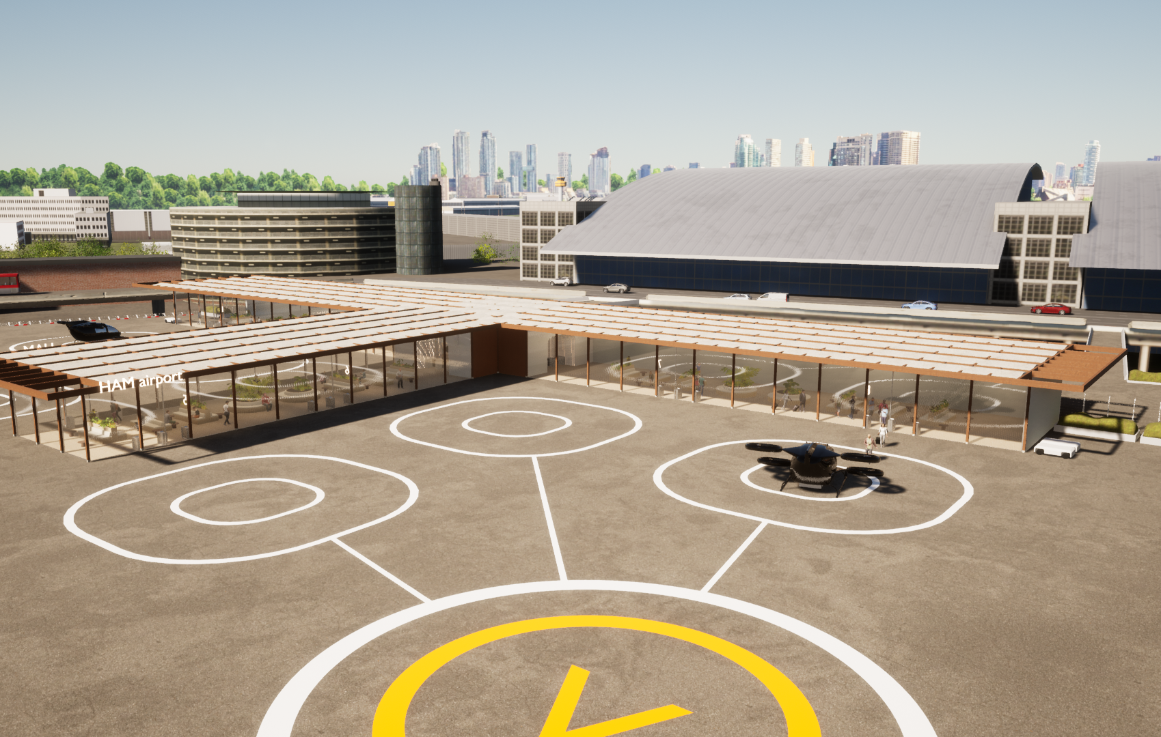



OVERVIEW
1
IAM & Vertiport
2
EUREKA Solutions
3
Operational Concept
Roles & Responsibilities
Airspace & Procedures Design
Traffic Management Services
4
Outlook: Whitepaper

Slide 3






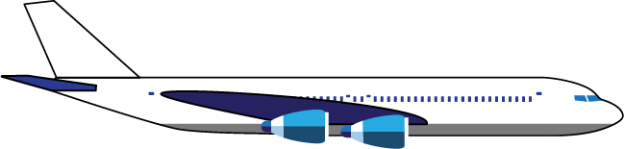



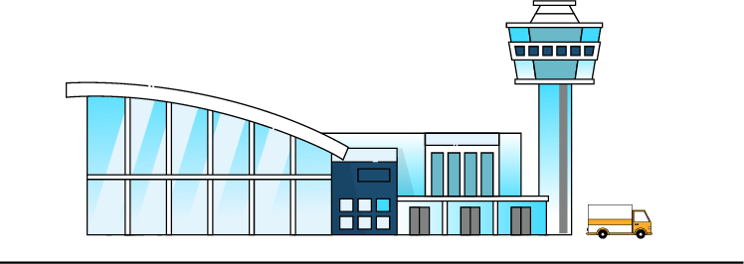

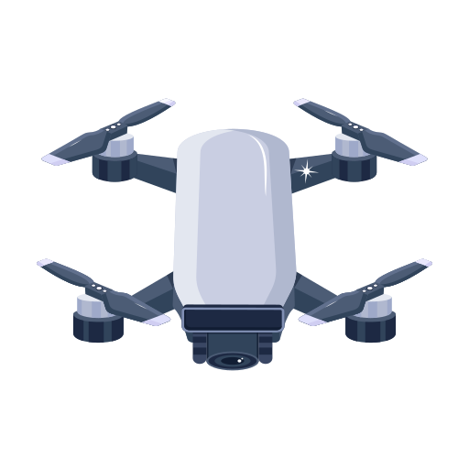

Innovative Air Mobility
Innovative Air Mobility (IAM): the safe, secure and sustainable air mobility of passengers and cargo enabled by new generation technologies integrated into a multimodal transportation system. [Source: EASA IAM Hub]
IAM in Europe demands safe, scalable and interoperable integration into legacy and emerging airspace structures.
ATM & U-space → Regulatory backbone!
Gap in low level airspace where IAM and certified VTOL-capable aircraft (VCA) operations are expected.
IAM/VCA operations question applicability and interoperability of ATM and U-space frameworks.
ATM
U-space

Slide 4
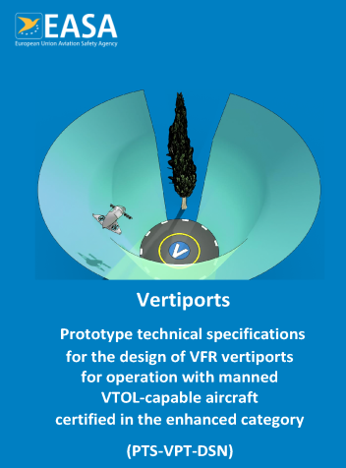
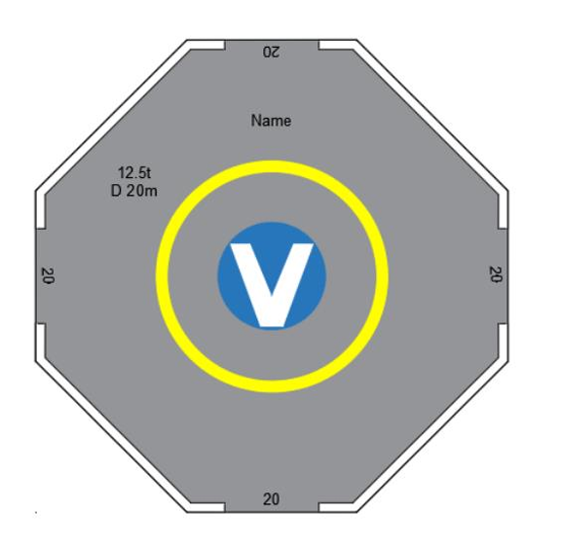
The Vertiport
Vertiport: an area of land, water, or structure that is used or intended to be used for the landing, take-off, and movement of VTOL-capable aircraft.
Vertiport: Central ground infrastructure element for VTOL-capable aircraft (VCA) connecting the urban airspace with the ground.
Operational status as critical information affecting all VCA flight phases.
A vertiport is not passive infrastructure. It is an active IAM operational node.

Slide 5
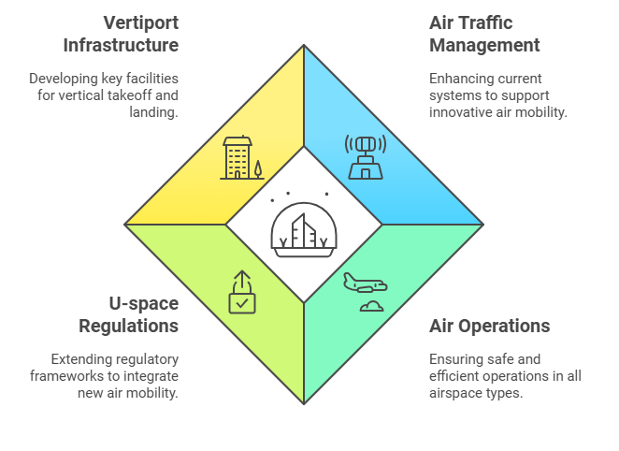
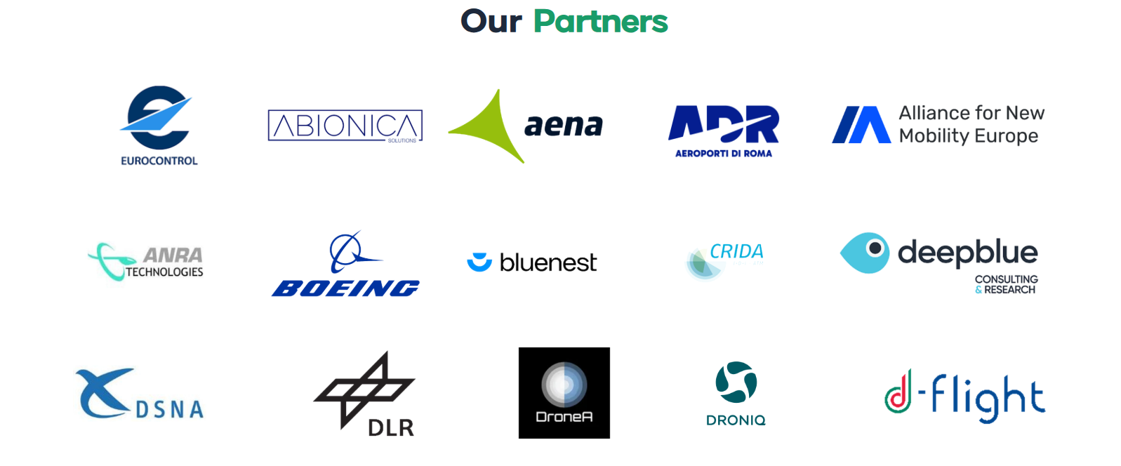
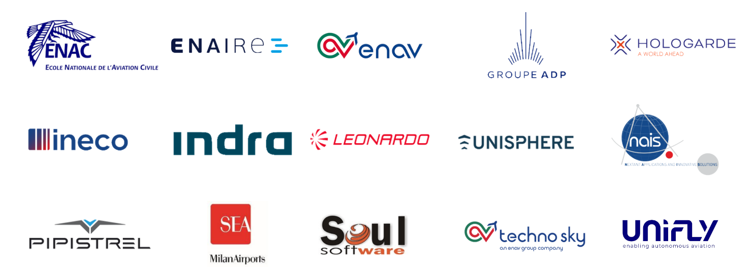
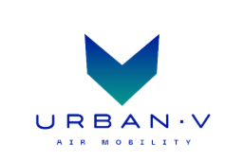

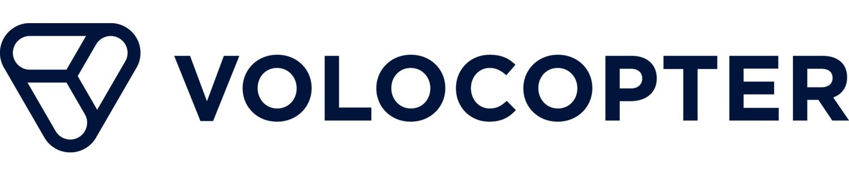
EUREKA
EUREKA stands out as the first SESAR project (initially under full U-space scope) to extend the current scope of the existing ATM, air operations and U-space regulatory framework, in particular, for vertiport stakeholders.
Duration: 3 years – 2023 to 2026
Fast-track Project (TRL1/2 – TRL6): From basic principles observed to system prototype demonstration in operational environment

Slide 6
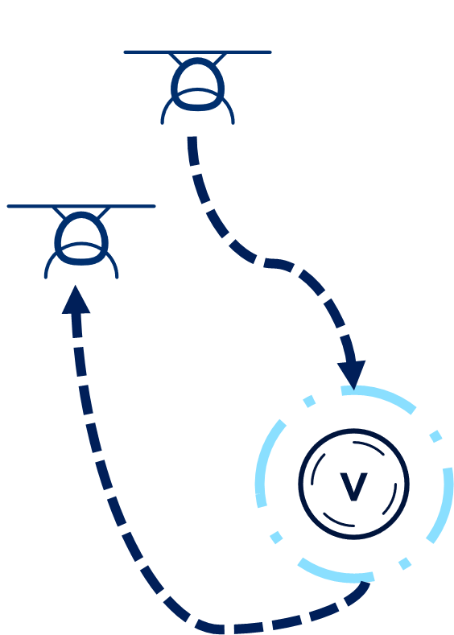
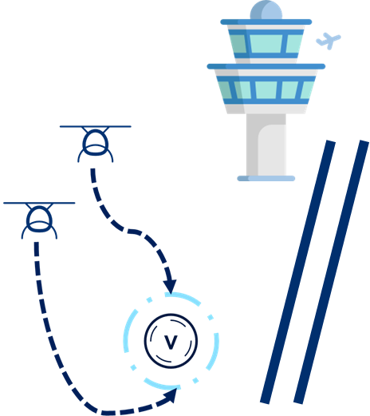
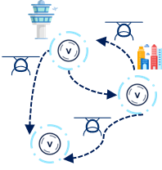

EUREKA Solutions
VCA Flight and Operating Procedures for Safe & Resilient Vertiport Operations
Vertiport Collaborative Traffic Management
Vertiport Network Flow, Capacity & Operational Management
Definition of airspace structures around vertiports for efficient take-off/landing, and approach/departure paths.
Requirements for VCA operations in controlled and U-space airspace.
Development of procedures for contingency events.
Near-term VCA introduction and long-term regulatory development.
Cooperative process supporting VCA operations in U-space.
Focus on key data exchange between stakeholders for safe operations.
Centralised airside information for effective vertiport management.
Common Information Service Provider as single and reliable source of all common information.
Network-level perspective on airside ground and flight operations across multiple vertiports.
Introduction of Local Vertiport Network Manager to improve efficiency and coordination & optimizes resources.
Avoid interference with ATM operations through Dynamic Airspace Reconfiguration.
SOLUTION 3
SOLUTION 2
SOLUTION 4

Slide 7
Elements of the Operational Concept
1
2
3
Airspace
and Procedure Design
Traffic Management Services
Roles and
Responsibilities
ATM
U-space

Slide 8
EUREKA Research Questions
1
Roles and
Responsibilities
What are the roles and responsibilities of stakeholders (including identification of potentially new stakeholders)?
What is the data model (architecture) and information exchange between stakeholders?
S3
Are ‘clearances’ and ‘clearance-like ’ authorisations required? If yes by whom and when?
S2

Slide 9
1
Roles and
Responsibilities
EUREKA Stakeholders
Vertiport Manager (VM)
Local Vertiport Network Manager
(L-VNM)
Vertiport Traffic Zone Manager
(VTZ Manager)
U-space Service Provider
(USSP)
Common Information Service Provider
(CISP)
ATM
Air Traffic Controller (ATCO)
Dynamic Airspace Reconfiguration Manager (DARM)
VCA Operator
VCA Pilot in Command
(PIC)
U-space

Slide 10
Clearances vs. „Clearance-Like“ Authorisations
1
Roles and
Responsibilities
Existing ATC clearance rules (ICAO PANS-ATM, SERA, IR 2024/1111) not designed for VCA operating in U-space.
EUREKA Approach for VCA operations
Authority
Controlled Airspace Environment
Terminology
ATC retains tactical clearance responsibility per ICAO/SERA. Vertiport availability must be confirmed before take-off clearance is issued. Information exchange takes place primarily between the VCA operator and VM; the ATCO receives vertiport details only through the flight plan.
Interoperability
Full U-space Environment
Timing
Responsibilities distributed across USSP, Vertiport Manager, and CISP.
Stepwise, digitally mediated authorisation sequence across three phases:
Strategic: USSP issues flight authorisation, contingent on confirmed destination slot
Pre-tactical: USSP requests taxi authorisation from VM; VM issues take-off authorisation at TLOF
Tactical: USSP requests landing authorisation; VM confirms pad availability or initiates diversion
Ground Operations
Energy Management
Handover
Coordinated digital handover. Automatic EST message (4D trajectory point+time) from ATCO system to USSP after take-off. USSP activates services & informs the VCA Operational Control Center. ACK from USSP to ATC when services in place.

Slide 11
2
Airspace
and Procedure Design
How is the vertiport location selected in airport environment?
Best practices and lessons learned of how to design flight procedures to/ from vertiports with focus on prescribed VFR and IFR.
S3
How can the airspace be designed /structured for uninterrupted flight and seamless operations with a few interventions as possible (ideally none)?
S3
What is the airspace design around a vertiport (need for ‘terminal’ airspace)
S3

Slide 12
Vertiport Location Selection in Airport Environment
2
Airspace & Procedures Design
Collision risk with runway traffic
Risk of collision b/w manned and VCA traffic below a Target Level of Safety (TLS). (MonteCarlo) Simulation against real traffic data. To be assessed site-specifically using actual traffic data.
Route compatibility with existing traffic
Containment boundary methodology to assess VCA route compatibility with existing airport operations. Applicable to any airport environment. Standard step in the vertiport placement assessment.
Meteorological usability
Wind analysis based on multi-year historical data to determine optimal track orientations.
Regulatory gap: lack of standardised wind restrictions for VCA.

Slide 13
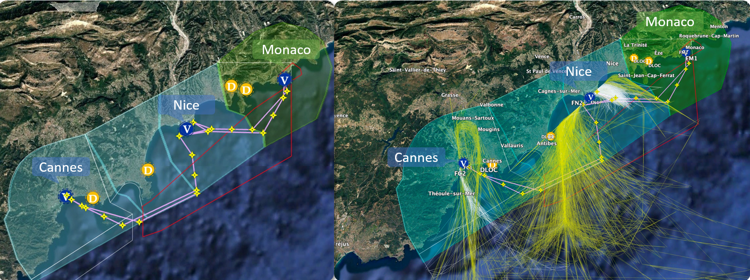
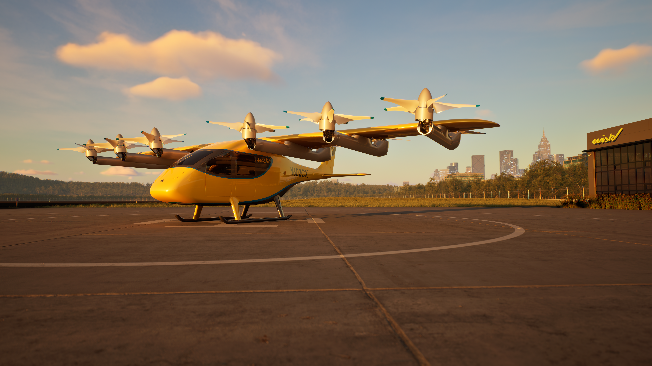
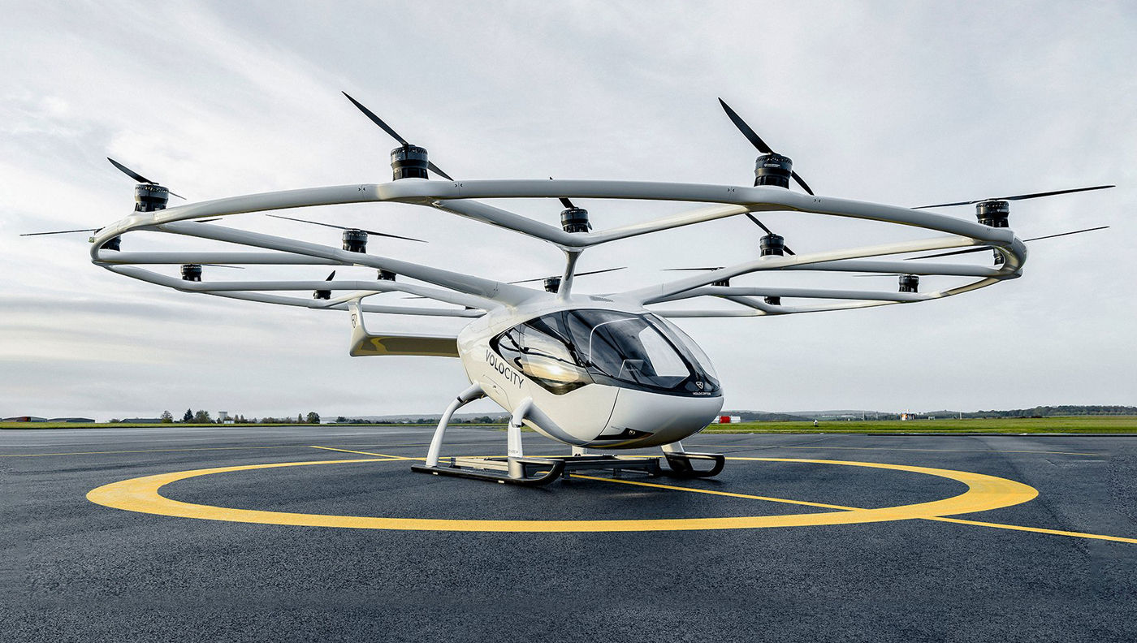
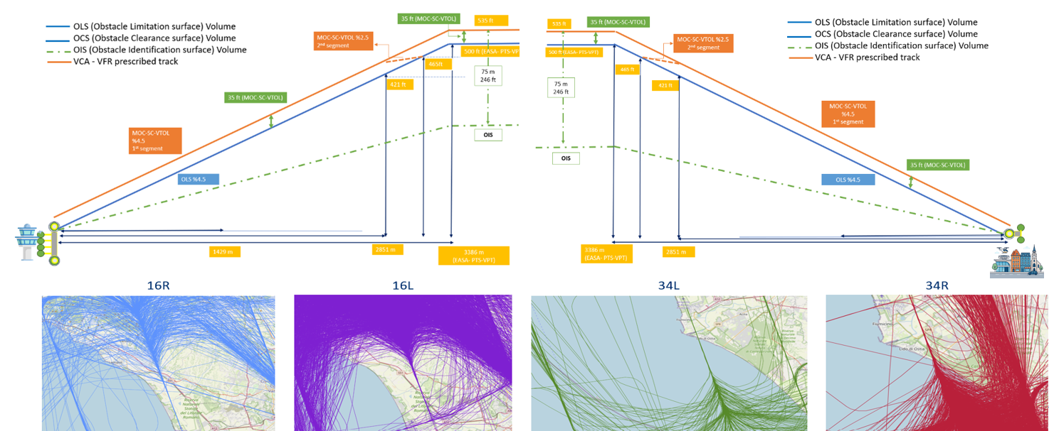
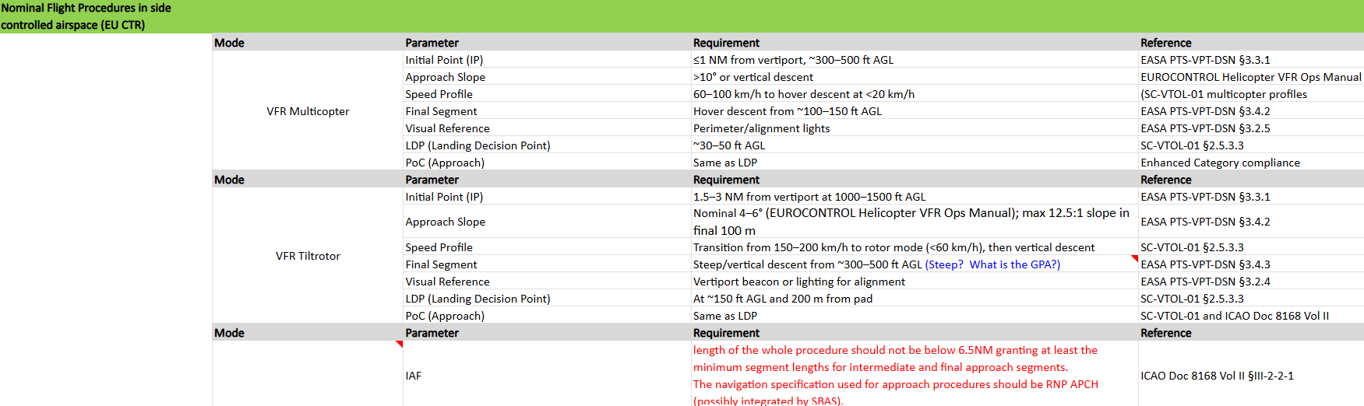


Flight Procedures Design (IFR/VFR)
2
Airspace & Procedures Design
1
1
The VCA flight procedure (VFR/IFR) design specifics:
  Based on VCA performance capability
  VCA approach, departure, and en-route flight paths should be separated from existing airways, SIDs, and STARs
  Ensure separation between VCA approach, departure, and en-route flight paths
    For example, approach and departure tracks should maintain a separation angle of 135 degrees
  Approach and departure procedures must consider obstacle limitations and define a minimum
  Define minimum and maximum en-route altitudes
  [……]
  Operating minima based on flight conditions and obstacle clearance requirements
  Define the Take-off Decision Point (TDP), Landing Decision Point (LDP), and Missed Approach Point (MAPt)
  Ensure compatibility with Continuous Safe Flight and Landing requirements (CSFL) requirement
IFR
©Wisk
Reference Aircraft
2
2
Prescribed VFR
©Volocopter
VFR/IFR
Iterative Process
Vertiport Location
Flight Procedure Design
Airspace Design

Slide 14
3
Traffic Management Services
What are the relevant traffic management services provided for a vertiport? What are vertiport services, what are ATC services and what are U-space services?
S2
How is the vertiport capacity planned and managed? How are the flow and capacity managed at the vertiport network level?
S4
S2
What is a vertiport slot? How are the vertiport slots allocated strategically and tactically?
S4
How can the A-CDM concept be used as an enabler for efficient vertiport operations? What aspects can be adapted, what changes, if any, need to be made that would lead to a V-CDM adaptation?
S2
What are the relevant operating procedures for VCA and vertiport operators during contingency situations en-route and near the vertiport?
S3

Slide 15
Traffic Management Services for Vertiport Operations
3
Traffic Management Services
Traffic Management Services are a combination of digital tools and operational procedures designed to enable IAM operations at and around vertiports.
The traffic management services relevant to vertiport operations span three distinct but interrelated domains.
Vertiport Management Services
Provided by the vertiport management entity through VM System.
U-space Services
USSP provides traffic management through digital services and information exchange.
U-plan Information Service
ATS Services
ATC services provided by ATCO when vertiport operates within or next to controlled airspace.
Vertiport Resource Management
Vertiport Availability Service
Vertiport Authorisation Service
Scheduling and Slot Allocation
Ground Movement Coordination
Passenger Flow Management
Additional mandatory services: Weather Info and Conformance Monitoring
CISP responsible for Common Information Service - include corridor availability, RT vertiport schedules, and vertiport contact information.
No change in core responsibilities but additional coordination with VMS, USSP, VCA operators (vertiport availability, handover coordination, contingency situations…)
These services operate in parallel and must be coordinated through shared digital infrastructure to ensure safe and efficient VCA operations.

Slide 16
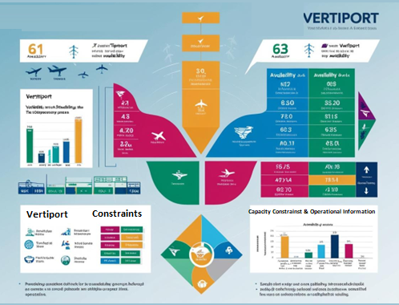
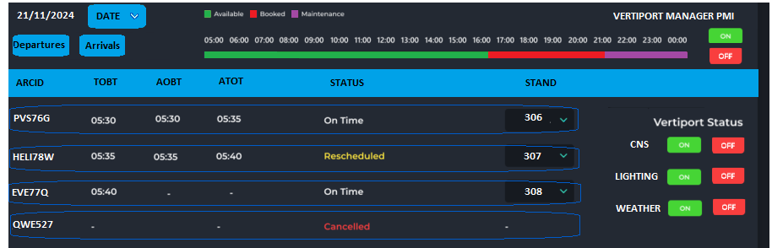
Vertiport Capacity
3
Traffic Management Services
Capacity Management
Infrastructure
Slot Allocation
Collaborative Decision Making
Vertiport Management System (VMS) main enabler of capacity management.
  Tracks the real-time status of all vertiport resources.
  Publishes vertiport availability data.
  Includes resource management, scheduling, and sequencing algorithms.

Slide 17
Flow and Capacity at Network Level
3
Traffic Management Services
Flow and capacity at the vertiport network level are managed through a set of interconnected mechanisms: strategic capacity determination, slot allocation, real-time operational oversight, and weather integration.
Coordinated by L-VNM supported by the Vertiport Network Management System (VNMS).
Vertiport Network Capacity Management
Flight Information Display System
Balances the vertiports resources with demand. Strategic phase: L-VNM needs to allocate time slots for landings and take-offs to avoid congestion.
Tactical phase: L-VNM as network orchestrator ensures that the scheduling is respected and/or adjusts the scheduling if needed.
Provides real-time flight information, including departures, arrivals, and gate information, to the VNM system users.
Ensures timely communication of critical flight data enhancing operational coordination.
Demand-Capacity Balancing as the Network Capacity Foundation → Implemented through the Vertiport Capacity Management subsystem
Resource Management subsystem manages capacity operationally through slot allocation.
Weather Monitoring
and Forecasting System
Resource Management System
Provides real-time weather data and forecasts for flight planning and operational decisions.
Enhances safety, improves operational efficiency, and minimizes disruptions by offering accurate weather information.
Manages resource allocation, including stands and ground services, to maximize operational efficiency.
Provides the USSP via CISP the vertiport availability

Slide 18
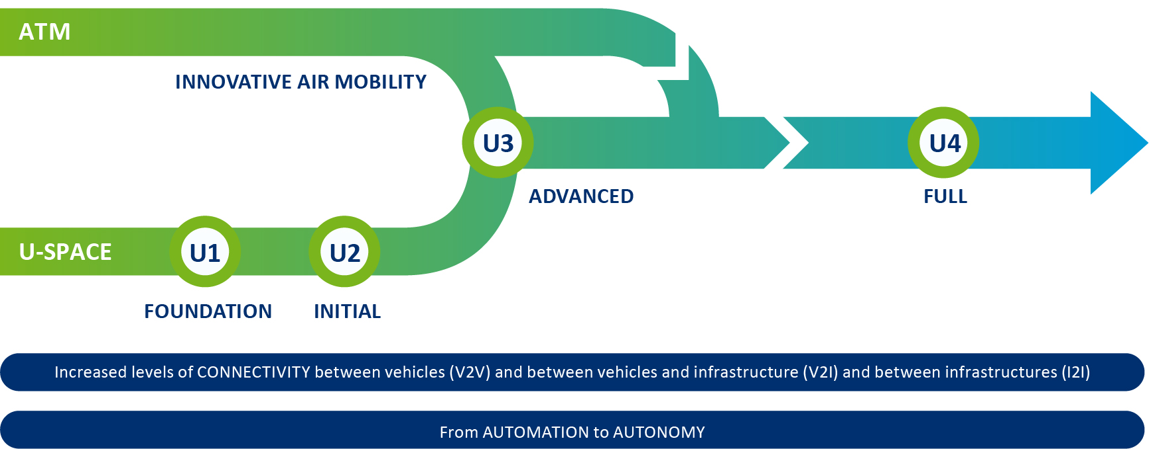
EUREKA Vision
EUREKA ‘26
up to TRL6
U-space regulation ’21/23
U-ELCOME ‘25
TRL8
Image Source: ATM Masterplan - SESAR Joint Undertaking | MP 3.5 Enabling new forms of mobility and uses of the sky

Slide 19
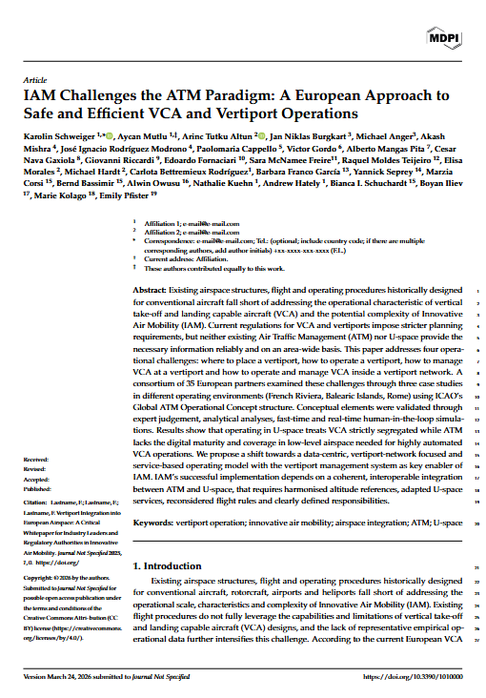
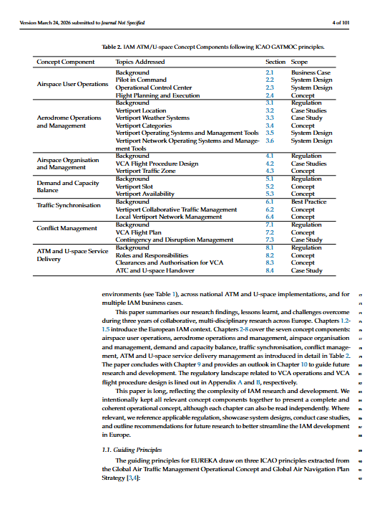




Outlook: Whitepaper
EUREKA ‘26
U-space regulation ’21/23
U-ELCOME ‘25
19 Partners
29 Authors
ICAO GATMOC Structure
~ 100 pages

Slide 20
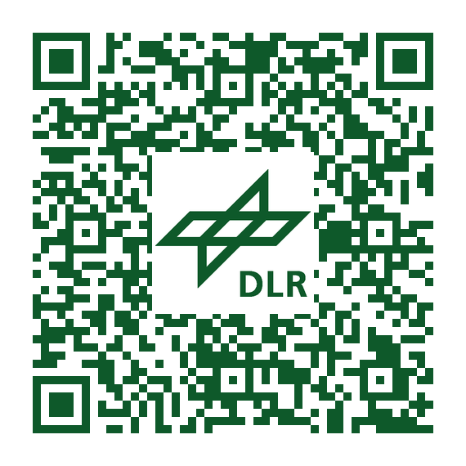

THANK YOU FOR
YOUR ATTENTION
EUREKA
Project
Marzia Corsi
marzia.corsi@dlr.de
  This project has received funding from the SESAR3 Joint Undertaking under the European Union’s Horizon EUROPE research and innovation programme under grant agreement No 101114799

Slide 21
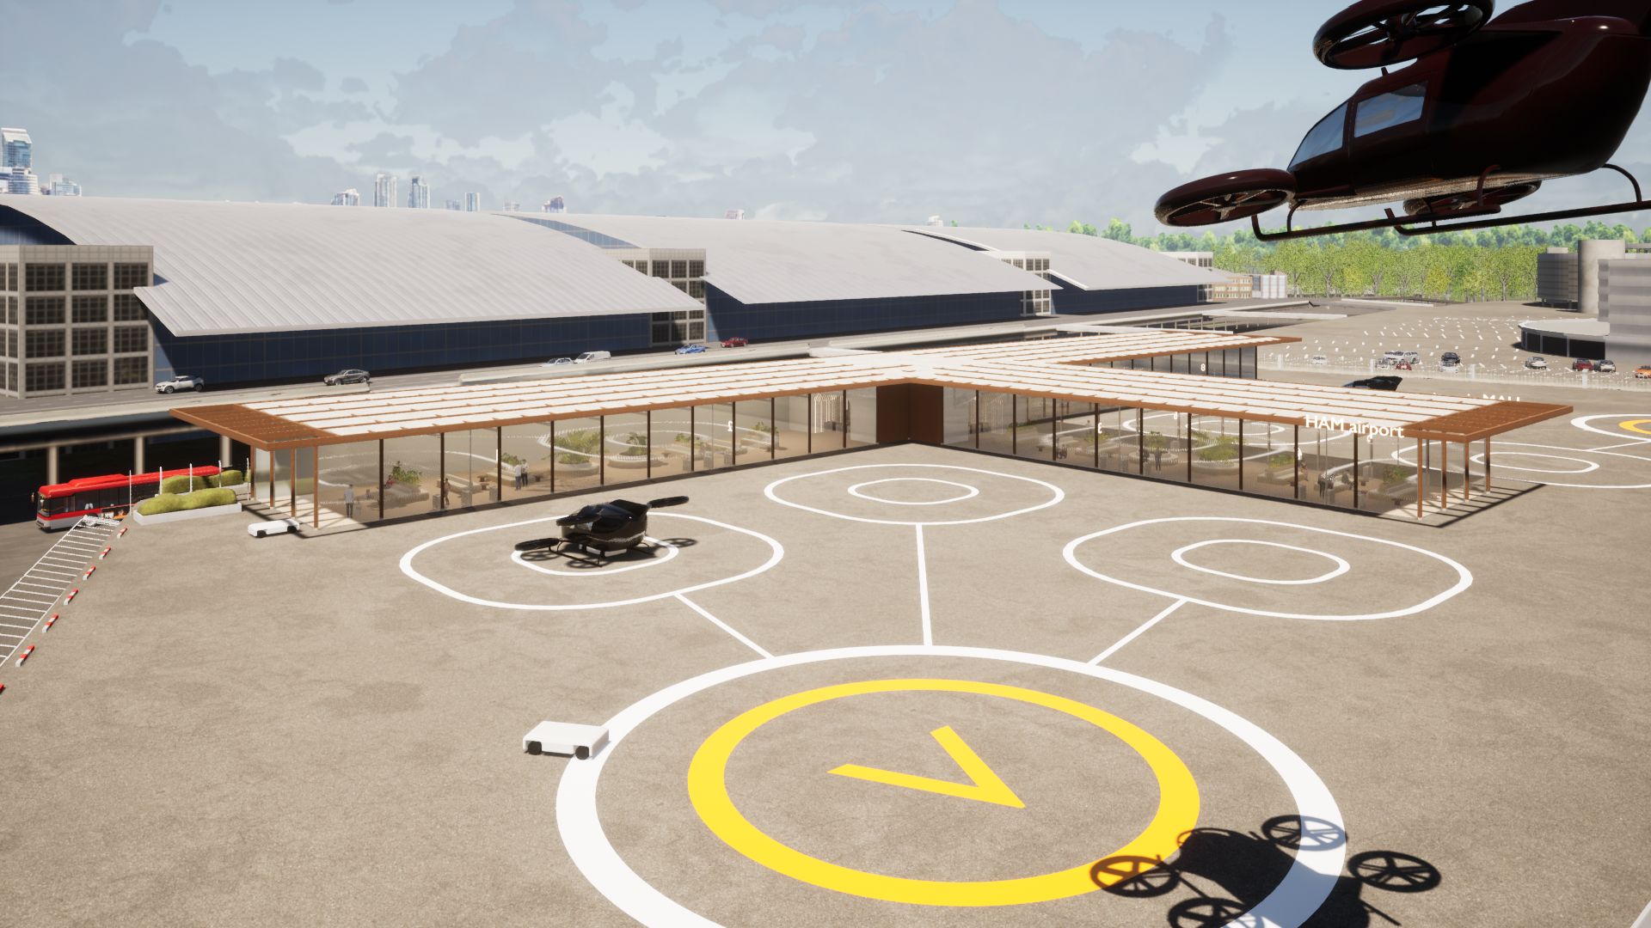




Follow us on LinkedIn
CALL FOR CONTRIBUTIONS OPENING SOON!
DLR Unmanned Aviation Research
DLR Institute of Flight Guidance

