Slide 1

EUREKA Final Event
Hulya KURTOGLU– Project Manager (EUROCONTROL)
EUropean Key Solutions for Vertiports and UAM
Cologne – 07/05/2026

Slide 2

Agenda
Opening Remarks (Cornelia Hillenherms, DLR)
Introduction - EUREKA Project (Hulya Kurtoglu, EUROCONTROL)
Keynote (Daan Dousi, Head of Department-IAM at EASA)
Overarching Concept of Operations (Marzia Corsi, DLR)
STAN & REG (Andrew Hately, EUROCONTROL)
  Coffee Break
Breakout Sessions (Solutions)
  Lunch Break
Breakout Session (Solutions)
Roundtable Discussion (Innovative Air Mobility and its impact on Air Traffic Management)
Wrap-up

Slide 3
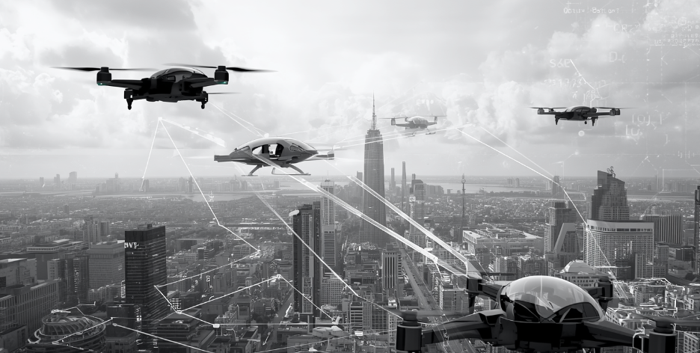
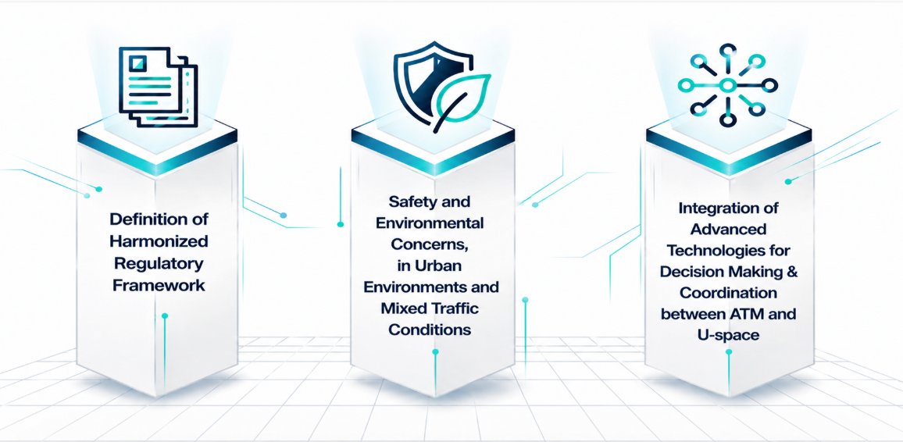
Operating in Emerging Domain
- Innovative Air Mobility -
Vision: to enable safe, sustainable, and efficient point-to-point mobility in urban, suburban, and airport environments

Slide 4
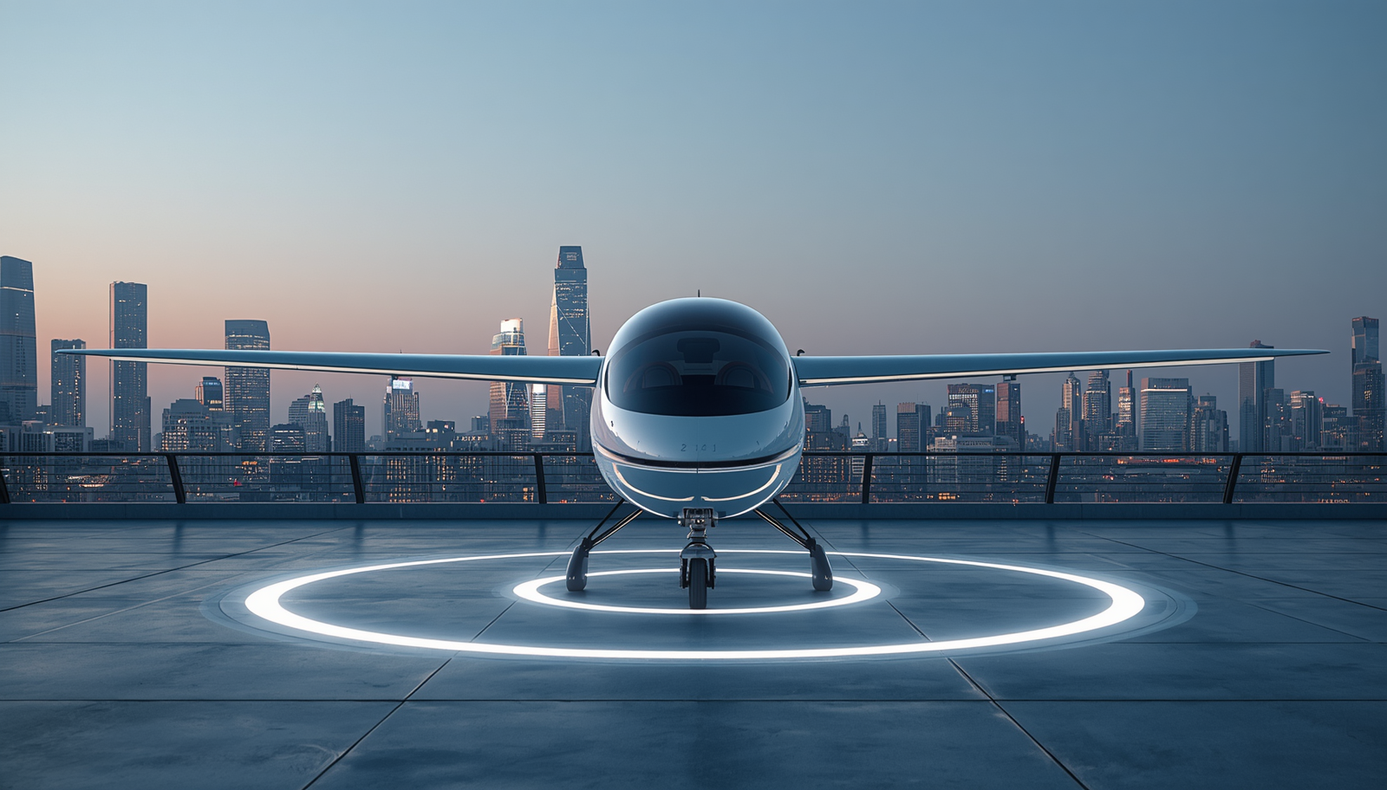
Contribution Areas
  Network Level
  Need to support flow and capacity management across vertiports and to better balance demand with available capacity
  Vertiport Level
  Need to define coordination of operations and exchange of information between vertiports
  Operational Level (VCA)
  Need for defined and scalable VCA flight procedures (VFR & IFR)

Slide 5

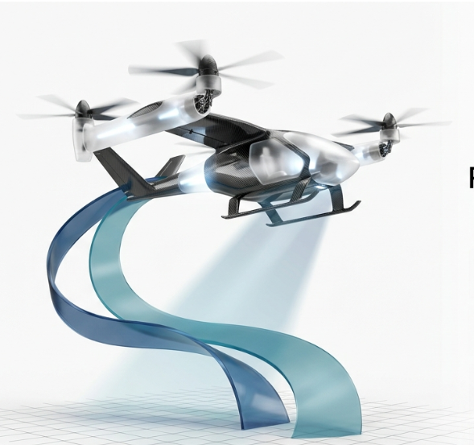
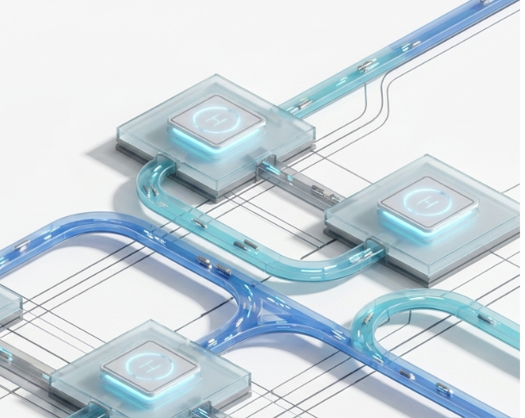


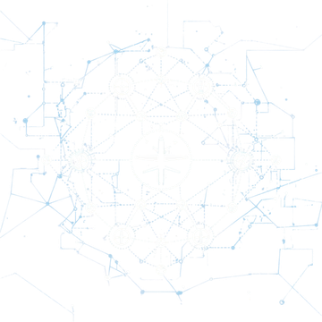
EUREKA Solutions Overview
Vertiport Collaborative Traffic Management
VCA Flight and Operating Procedures for Safe and Resilient Vertiport Operations
Vertiport Network Flow, Capacity and Operational Management
Leader: AENA
Objective
Improve vertiport-level operations through collaboration and efficient resource use
Scope
• Adaptation of A-CDM vertiport operations
• Vertiport slot, capacity and availability management
• Real-time vertiport data exchange via CISP
• Coordination between Vertiport Manager, USSP and IAM Operators
Leader: Boeing & SEA Milano & Hologarde
Objective
Define safe and scalable operating and flight procedures for VCA operations, and their eventual integration into U-space
Scope
• VFR & IFR procedures for VCAs
• Address abnormal and faulted scenarios by contingency management procedures, via CDS (Contingency Decision Support System)
• Coordination between VCA, ATC, USSP and Vertiport Operator
Leader: ADR & UrbanV
Objective
Manage interconnected vertiports at network level by balancing demand and capacity
Scope
• Strategic and real-time demand–capacity balancing (DCB)
• Network-wide slot allocation and resource optimisation
• Interoperability between VNMS, CISP and USSPs

Slide 6
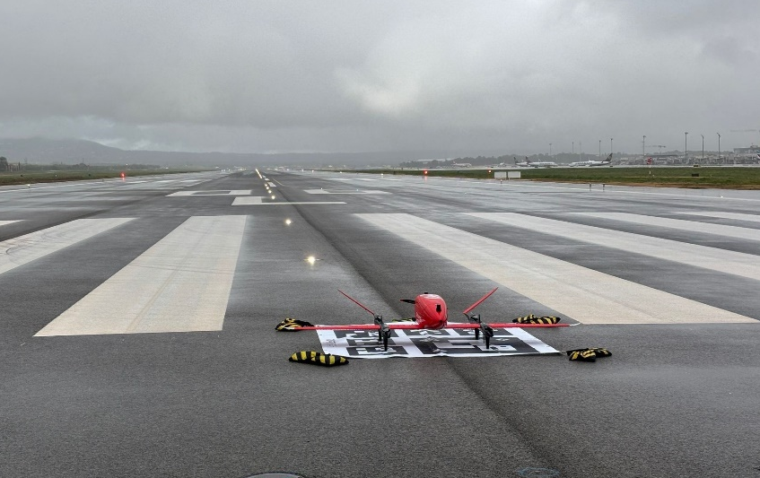
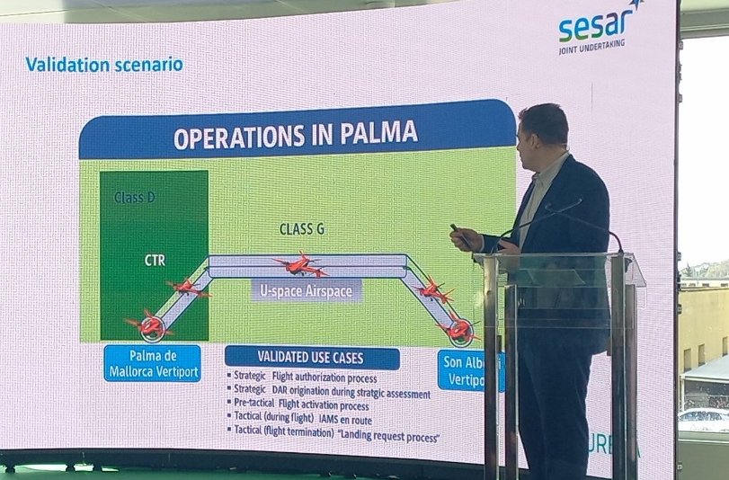
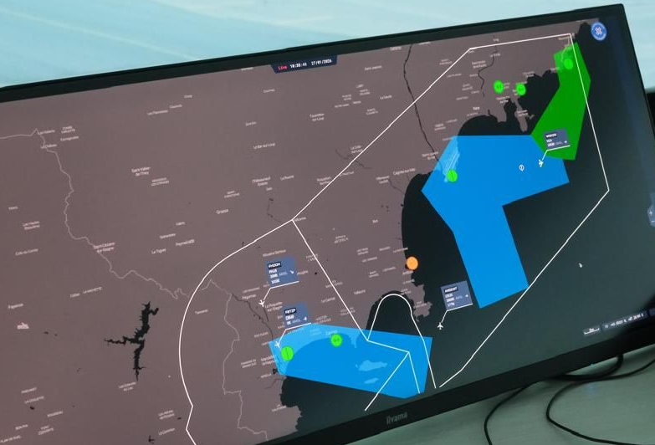
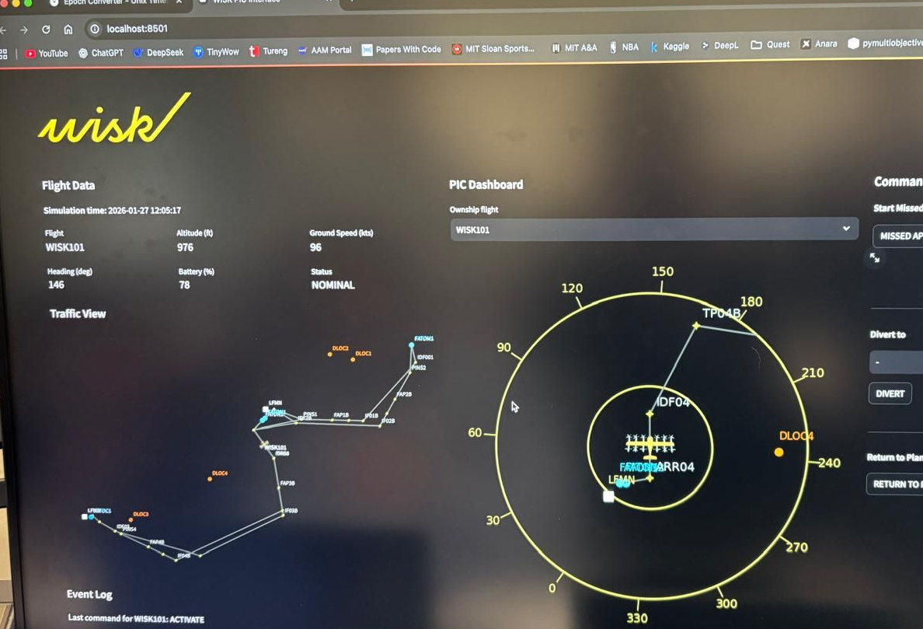
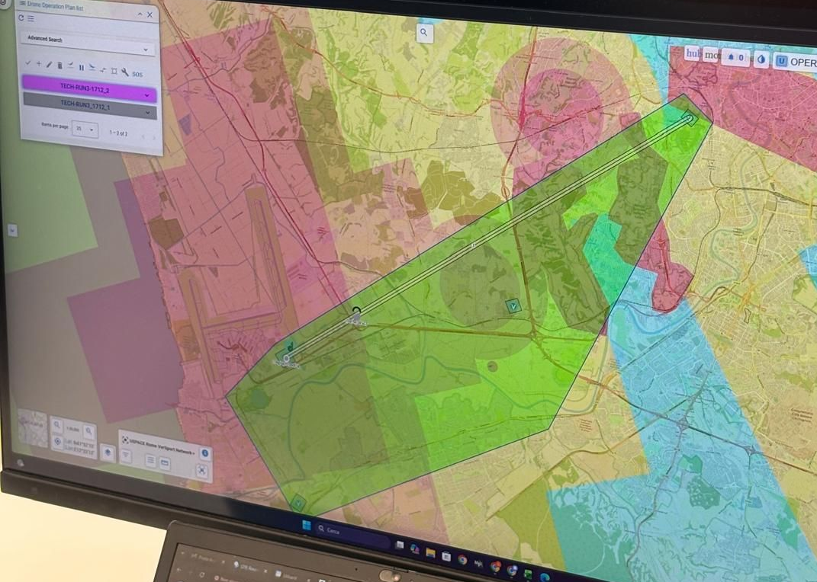
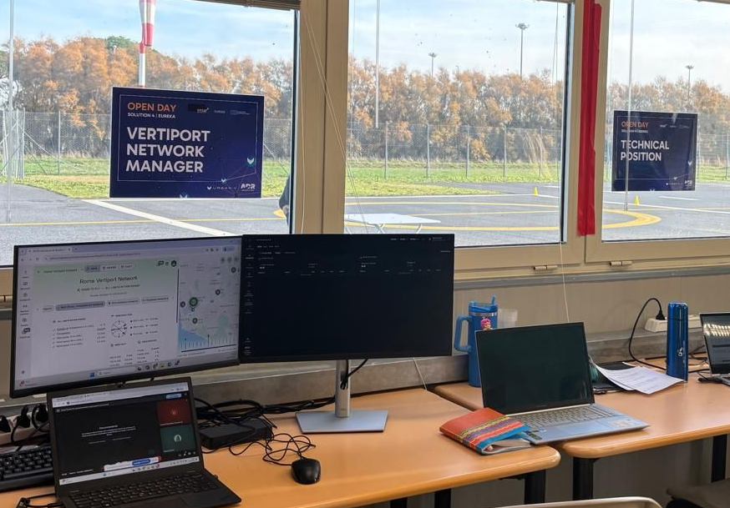
Validations Path
Solution 2 – Vertiport Collaborative Traffic Management
• 11 exercises
• Analytical methods, prototyping, expert workshops, real-time simulations + live trial
• Vertiport operations (authorization, corridor, landing)
• Between Palma Airport and Son Albertí Aerodrome in Spain
Solution 3 – VCA Flight and Operating Procedures
• 5 exercises
• Expert workshops, fast-time simulations, real-time simulations
• VCA operation and flight procedures
Solution 4 – Vertiport Network Flow, Capacity & Operational Management
• 3 exercises
• Fast-time simulations, expert workshops, real-time simulations + live trial
• Network operations
• at the Pianabella Test Vertiport near Rome Fiumicino Airport-Italy

Slide 7
Conclusions
The three solutions demonstrated strong and consistent results across different areas.
TRL 6
TRL 4
TRL 6
Solution 2 (VCTM)
• Reached Conditional TRL6 - confirming VCTM operational performance and efficiency and showing clear improvements in human performance
• Strong interoperability (100%), +20% capacity, +13% predictability, −20% costs
Solution 3 (VCA Flight and Operational Procedures)
• TRL4 achieved – demonstrating VCA operations technically feasible and safe
• Zero safety events, high punctuality (98–100%)
• Fast disruption response (~3 sec) enabled by CDS
Solution 4 (Vertiport Network Flow, Capacity & Operational Management)
• Reached Conditional TRL6 - confirming that network-level coordination is operationally viable, with high efficiency and low operator workload
• +17% network capacity, +22% throughput, 100% interoperability
Improved Human Performance
Technically Feasible and Safe Operations
High Efficiency and Low Operator Workload

Slide 8

Recommendations & Future Work
Vertiport Operations
Further validation in mixed traffic environments
VCA Flight Procedures
Investigate performance-based separation
Improve coordination with airport procedures
Assess safety under non-nominal conditions
Validate operations under higher traffic densities
Optimize diversion strategies
Vertiport Network Management
Conduct large-scale flight trials
Improve resilience under degraded conditions
Enhance capacity management

Slide 9
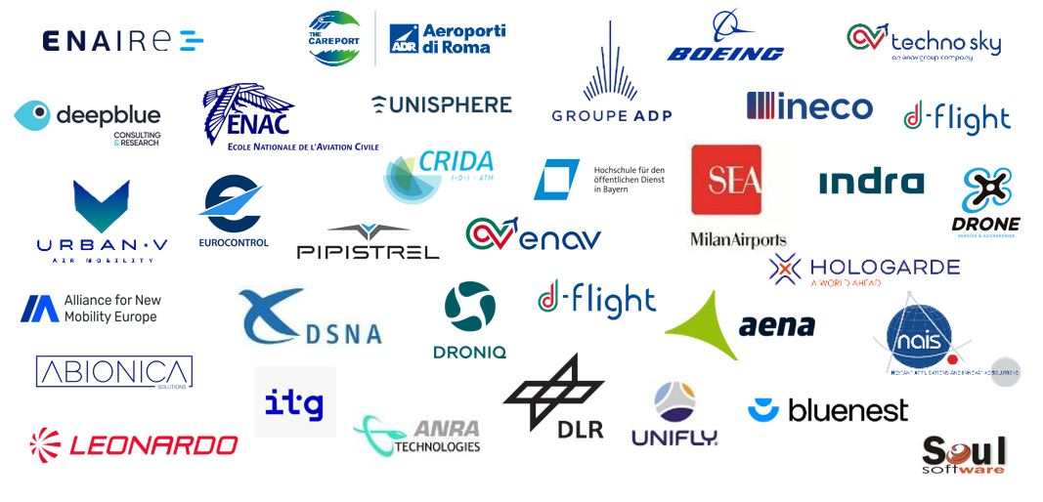
Thanks to all EUREKA partners for making this possible

Slide 10
hulya.kurtoglu@eurocontrol.int

